Slide 1
FDSc Assistant Practitioner (Health and Social Care) &
BA (Hons) Top-up degree: Applied Health and Social Care
A Combined Overview
Department of community, Social Justice and Health
An integrated approach to
health and social care education
Lisa Mauro-Bracken
l.mauro-bracken@worc.ac.uk

Slide 2

Health and Social Care Programme Context… From Level 4 to Masters
Programme Roles and Progression
  FdSc Assistant Practitioner offers foundational care, support, clinical and organisational skills, while APHS Top‑up Degree advances professional autonomy and analytical abilities.
Inclusive Support and Accessibility
  Programmes support diverse learners using blended learning and strong employer engagement to widen participation and social mobility.
Workforce Development Alignment
  Courses address regional workforce needs by preparing skilled practitioners for roles in health, social care, and community services.
Collaborative Departmental Expertise
  Shared departmental resources foster collaboration among academics in public health, mental health, and community engagement.
Notes:
The FDSc Assistant Practitioner (Health and Social Care) and the BA (Hons) Applied Health and Social Care Top‑up programmes occupy a central role within the Department of Community, Social Justice and Health, reflecting the University of Worcester’s wider commitment to accessible, practice‑informed education. Both programmes are situated within a portfolio designed to support progression from foundation‑level study through to advanced undergraduate attainment, ensuring that learners at varying stages of professional development can access a coherent and supportive educational journey.
The FDSc Assistant Practitioner programme provides a structured entry point for individuals seeking to develop clinical, care-focused, interpersonal and organisational competencies relevant across health and social care settings. In contrast, the APHS Top‑up degree builds upon prior Level 4–5 learning, emphasising professional autonomy, analytical capability, and a capacity to contribute to service improvement across statutory, voluntary and community sectors.
Collectively, the programmes serve a diverse student body, many of whom are mature learners balancing employment, caring responsibilities or part‑time study. By embedding blended learning, supportive academic environments and strong employer engagement, the programmes align well with the University’s commitment to widening participation and enhancing social mobility.
This contextual positioning also supports regional workforce development, addressing employer needs for skilled practitioners who can progress into roles such as Assistant Practitioners, support workers, wellbeing officers or community‑based coordinators. Furthermore, the alignment across FdSc and Top‑up pathways ensures that students experience a clear developmental trajectory, moving from foundational concepts such as person‑centred care and interprofessional practice into more advanced themes including leadership, change management, contemporary issues in mental health, and critical engagement with the ‘trio of vulnerabilities’.
This structuring provides clarity for learners while also meeting employer expectations for adaptable, reflective and resilient practitioners who can respond to evolving workforce needs. The shared departmental environment also enables collaborative working between academic staff with expertise in public health, mental health, social care, domestic abuse, paramedic science, Allied Health, research and community engagement, enriching the curriculum and supporting effective preparation for practice.

Slide 3

Department Community, Social Justice and Health | Department Health and Well-being
Foundation Degree with pathways | Top-up Degree | Masters courses
Assistant Practitioner (Health and Social Care) FdSc with Assistant Practitioner Apprenticeship Option Pathways enabling progression into: Nursing​ Nutrition & Dietetics​ Occupational Therapy​ Physiotherapy Paramedics​* | BA (Hons) Applied Health and Social Care Other Top up courses also available Leads to Progression to postgraduate study | MA Social Work MSc Leadership and Management in Healthcare MSc Occupational Therapy MSc Physiotherapy MSc Counselling PGCert - Mental Health and Wellbeing Practitioners PG Cert – Person Centred Dementia Care PGDip/MSc – Nutrition and Lifestyle Medicine
*subject to mapping

Slide 4
FdSc Course Structure, Pathways and Learning Design
Dual Pathways Design
  The FdSc offers apprenticeship and direct-entry pathways blending academic study with practical work-based learning.
Blended Study Model
  Learning includes on-campus, online sessions, practical/skills simulation and placement to balance flexibility with academic rigour.
Progressive Curriculum
  Year one builds foundational care and professional skills; year two enhances research, leadership, and optional specialisms.
Integrated Support System
  Supervision, formative assessments, and pastoral care ensure learner competence and professional identity growth.
Notes:
The FDSc Assistant Practitioner programme is designed as a two‑year foundation degree with two distinct routes: the apprenticeship pathway and the direct‑entry pathway. Apprentices remain employed within health or social care settings while undertaking academic study, benefitting from integrated work‑based learning that aligns with their employment responsibilities. Direct‑entry learners follow a similar curriculum structure may be employed in their placement settings but also can source placements either independently or with support from the university, enabling them to gain essential practice experience across diverse environments.
The study model blends on‑campus learning one day per week with an additional half‑day online component and at least one day per week in placement or practice‑based learning. This format enables flexibility while maintaining academic rigour and appropriate contact time. We use the skills simulation rooms and anatomical learning resources to support learning.
Year 1 introduces core concepts including person‑centred care, professionalism, the fundamentals of health and care science, health promotion, interprofessional collaboration and reflective skill development. Year 2 builds upon this foundation with modules in research and evidence‑based practice, leadership, innovation, workplace projects and optional specialism modules such as complex needs, physiotherapy principles, occupational therapy foundations or nutrition and dietetics.
The curricular design ensures that learners progressively build competence, confidence and professional identity, supported by structured supervision, formative assessment opportunities and strong pastoral care. Teaching activities incorporate simulation, clinical skills development, digital learning tools, group work and facilitated reflective discussion. Access to specialist university facilities, including skills labs and anatomical learning resources, enhances applied learning through visualisation, observation and scenario‑based practice.
Work‑based learning forms a substantial component of the programme, enabling students to apply knowledge to real‑world contexts, develop workplace competencies, and reflect on professional behaviours. Students are supported throughout by supervisors, academic tutors and placement educators who help bridge academic learning with practice expectations. This integrated learning approach strengthens employability and ensures alignment with workforce needs.

Slide 5
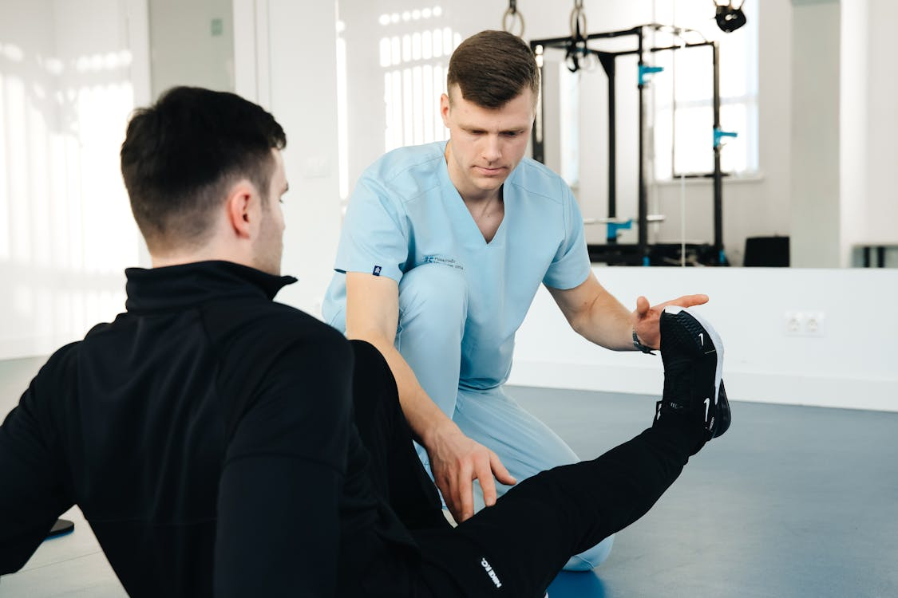


Assistant Practitioner (Health and Social Care)
Year 1 | Year 2
Person Centred Care | Research and Evidence Based Practice
Anatomy and Physiology | Innovation and Leadership in Health and Care
Becoming a Health and Care Professional | Individual Project for the Workplace
Promoting Health and Well-being | Optional Modules as follows:
Skills for Interprofessional Working | Care and Support of Complex Needs Principles of Physiotherapy Principles of Occupational Therapy Principles of Nutrition and Dietetics
Work Based Learning

Slide 6

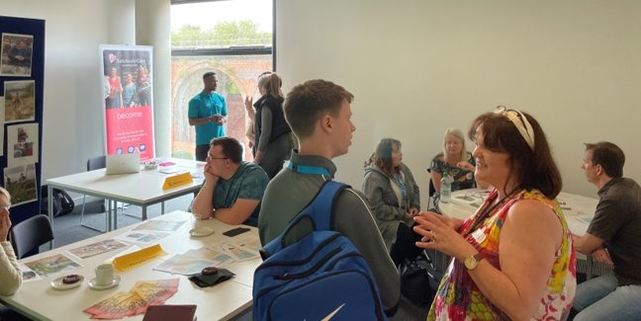

Theory to Practice: Work Based Learning
Students complete assessed placement setting hours over the academic year (see course detail)
Range of different settings, and geographical locations (including own employment) – students are asked to source a placement before commencing the course (support provided to find placements).
Opportunity to link theory to practice, develop personal and professional skills, increase confidence, and gain a wealth of experience and knowledge in a health and social care setting.
Individual learning outcomes and requirements will depend on the course and level but will involve reflecting on your practice and goal-setting, and planning and implementing a project.

Slide 7
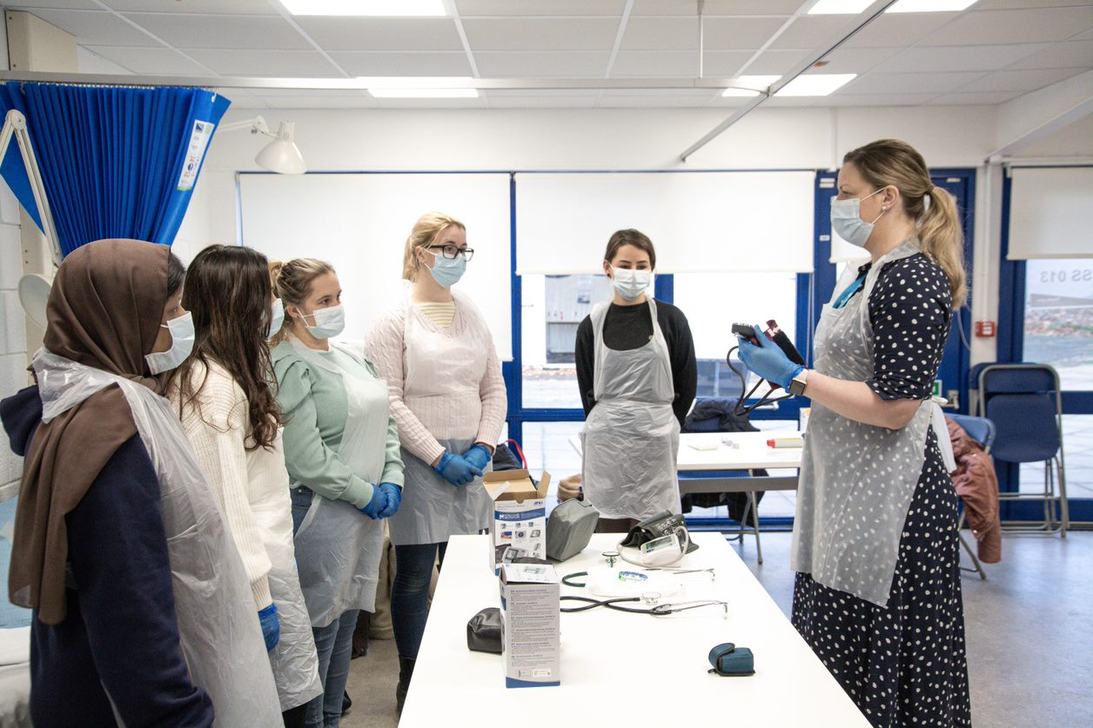
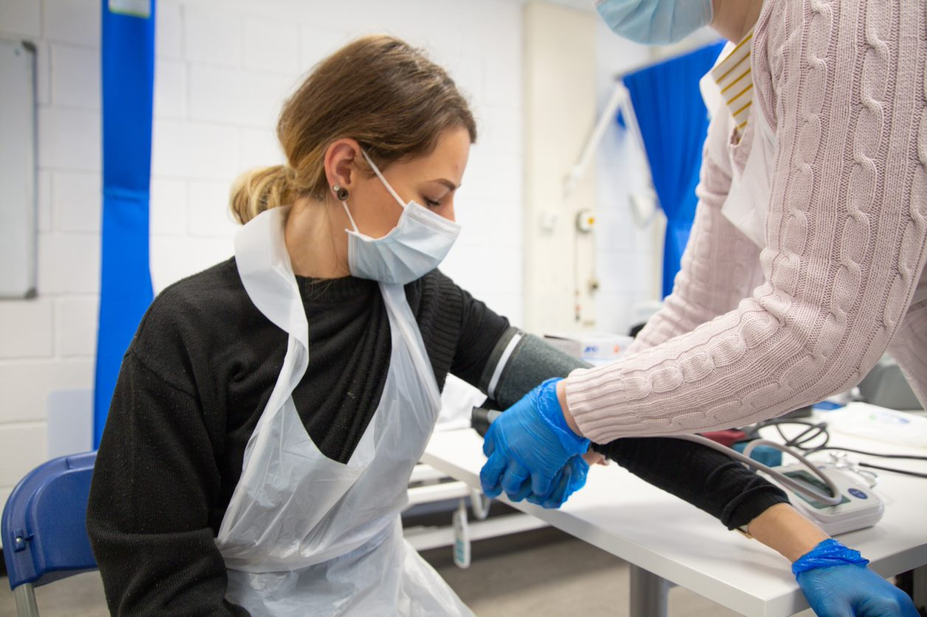
Teaching and Learning: Specialist Activities…
Notes:
Teaching includes skills rooms, healthcare technologies, and anatomical learning resources
Important part of the course because Assistant practitioners/senior support in care settings bridge between support staff and registered health/social care professionals.
This includes physical assessment activities for A/P in various skills rooms, looking at various technology used in health care, use of the anatomical lab in the medical school (table that takes a body and dissects it layer by layer looking at the various structures, changes due to a specific condition and what led to the death of the person plus in year 2 more specific activities related to managing conditions.

Slide 8
Role and Scope of the Assistant Practitioner
Bridging Care Roles
  Assistant Practitioners bridge support staff and registered professionals, ensuring continuous, safe, high-quality care.
Clinical Responsibilities
  They perform clinical observations, therapeutic engagement, health promotion, and basic interventions with autonomy.
Training and Development
  The FdSc program develops understanding of person-centred care, safeguarding, anatomy, and multidisciplinary teamwork. Programme focuses on understanding wider determinants, social contexts, lived experiences and personal choice.
Workforce Impact
  Assistant Practitioners improve service efficiency, allowing registered professionals to focus on specialised tasks.
  Highly Skilled, non-registered practitioners; often working without direct supervision; patient/service user/resident facing roles across various settings
Notes:
The Assistant Practitioner role provides an essential bridge between support staff and registered health and social care professionals, ensuring continuity, safety and high‑quality care delivery across a wide variety of clinical and community environments. Assistant Practitioners operate with a high level of responsibility and autonomy, often undertaking delegated tasks without direct supervision while remaining accountable to a registered professional for oversight and guidance.
The FDSc programme equips learners with a deep understanding of person‑centred care, professional behaviour, safeguarding responsibilities and applied anatomy and physiology, enabling them to contribute effectively to multidisciplinary teams. Assistant Practitioners work across hospitals, GP surgeries, residential care settings and in the community, frequently supporting individuals with long‑term conditions, acute needs or complex vulnerabilities.
Their role includes clinical observations, therapeutic engagement, health promotion activities, basic clinical interventions, and communication with families, carers and other professionals. The training emphasises understanding the wider determinants of health, ensuring that learners can support individuals in ways that reflect social context, lived experience and personal choice. Trauma informed care is a key discussion point when working through case studies.
Additional focus is placed on the development of reflective practice and emotional intelligence, both of which are crucial for building resilience and maintaining high‑quality interactions in demanding environments. The FDSc equips learners with the ability to interpret guidance, follow protocols, and engage in safe decision‑making while also understanding when to escalate concerns or seek professional advice. Through placements and structured work‑based learning, learners gain exposure to real‑world settings where they link theory to practice, applying their developing skills in direct care activities, communication scenarios and record‑keeping responsibilities. As the role continues to evolve within modern health and social care systems, Assistant Practitioners contribute significantly to service efficiency, enabling registered professionals to focus on specialised tasks while ensuring continuity and reassurance for service users. In this way, the FDSc programme strengthens both individual capability and workforce capacity.

Slide 9

Applied Health and Social Care BA (Hons) Top-up Degree

Slide 10

A broad range of disciplines represented in student cohort
Counsellor
Social Worker
Ophthalmologist
Paramedic
IT manager

Slide 11
APHS Course Vision, Philosophy and Contemporary Themes
Course Purpose and Vision
  The degree develops critical thinkers and leaders who contribute meaningfully to complex health and social care settings.
  Creating Professional Identity
Trio of Vulnerabilities
  Focus on substance misuse, mental health, and domestic abuse encourages holistic, multidisciplinary responses.
  Trauma informed working
Philosophy and Values
  Emphasises reflective practice, empowerment, cultural competence, solution focused/strengths-based approaches and anti-oppressive frameworks in care delivery.
  Person-centred care
Flexible Learning and Support
  Blended learning supports diverse students including working professionals and carers with inclusive teaching.
Notes:
The BA (Hons) Applied Health and Social Care Top‑up degree builds upon prior Level 4–5 study to develop practitioners capable of critical thinking, leadership and meaningful contribution to complex health and social care environments.
The course centres on the University of Worcester’s commitment to producing graduates who act as ‘agents of change’, advocating for human dignity, social justice and equitable access to services. The curriculum foregrounds resilience, professional autonomy and the capacity to engage critically with rapidly evolving challenges across the sector.
A key thematic framework underpinning the programme is the ‘trio of vulnerabilities’: substance misuse, mental health and domestic abuse. This concept reflects interconnected experiences that affect individuals across the life‑course and require coordinated, holistic responses from practitioners. The theme encourages learners to adopt a multi‑disciplinary mindset, recognising the interplay between social determinants, trauma, public health, community interventions and safeguarding responsibilities.
The course philosophy emphasises reflective practice, empowerment, community engagement and strength‑based approaches that support individuals and communities in diverse settings. The curriculum incorporates contemporary policy, evidence‑based practice, ethical considerations, cultural competence and anti‑oppressive frameworks. Students are encouraged to critically evaluate services, challenge inequalities and explore innovative responses to unmet needs.
The programme’s flexible delivery model accommodates both full‑time and part‑time learners and supports those returning to education after extended breaks. Its blended learning design enables accessibility for working professionals, carers and individuals balancing multiple commitments. The course fosters a supportive academic environment with small group teaching, accessible tutors and inclusive pedagogical practices. Specialist dissertation supervision strengthens academic development, research confidence and the ability to design and implement small‑scale service improvement projects.
Overall, the APHS Top‑up cultivates practitioners with the knowledge, skills and values needed to influence practice, contribute to organisational change and respond effectively to contemporary social challenges.

Slide 12

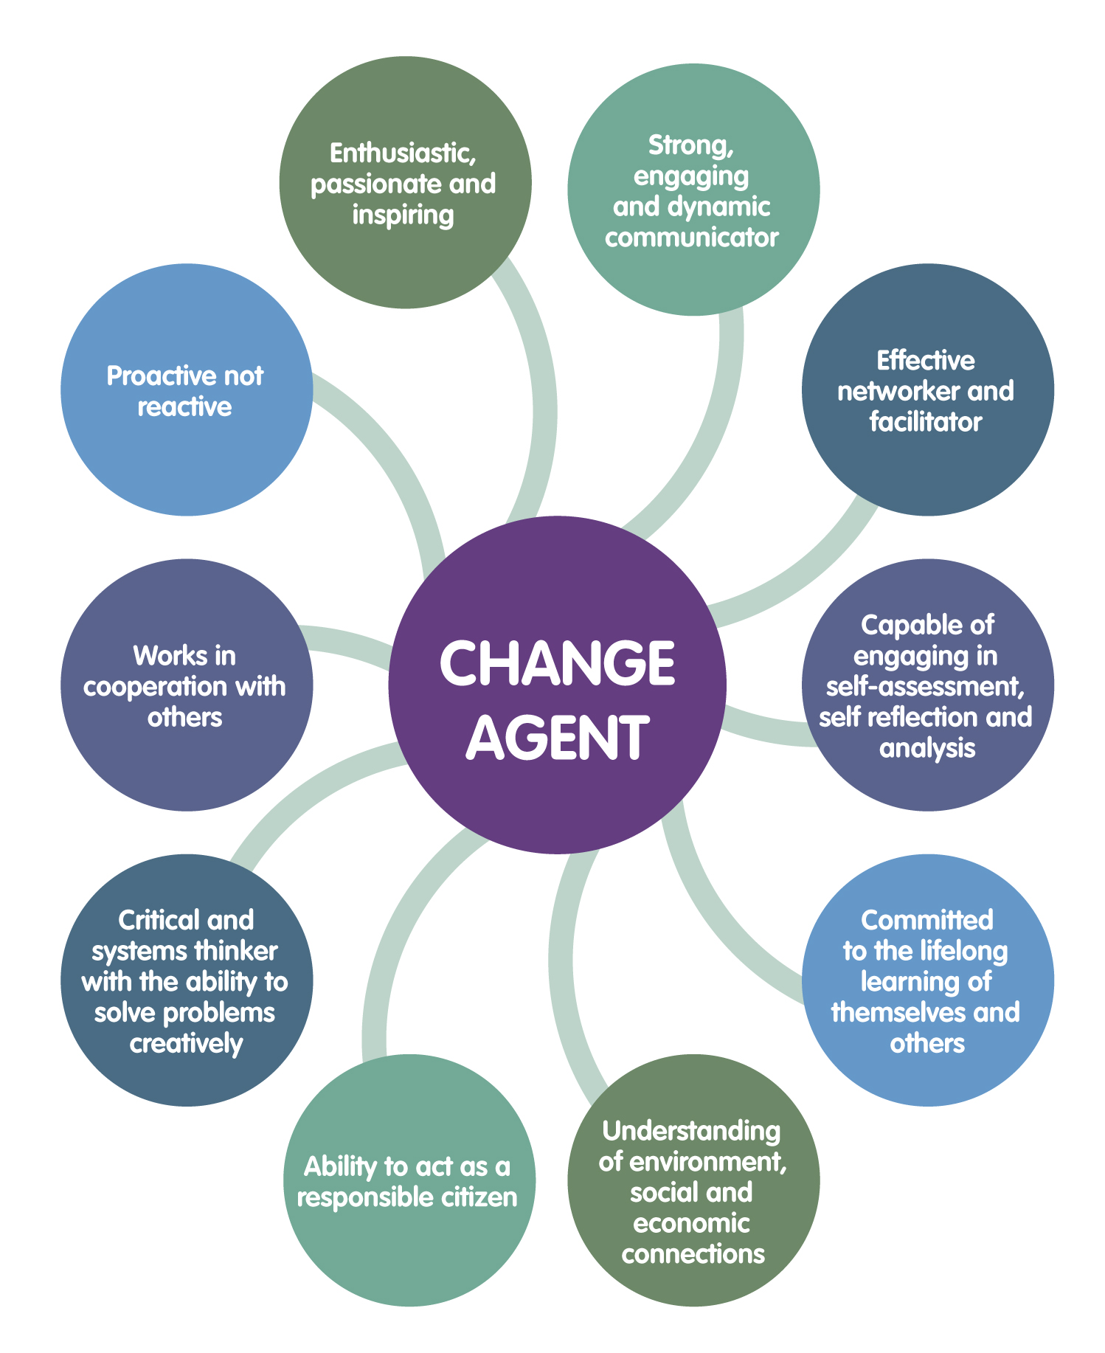

Key features and structure of the Course
Flexible - available as 1-year (full-time) or 2 year (part-time).
Highly blended/online option available from September 2026*.
Ideal for those seeking day-release from work.
Taught by broad range of practitioners with specialist supervisory support for dissertation
Strong reputation for being highly supportive environment and ideal for those returning to education following a break
  Core modules: Semester 1 focus domestic abuse, mental health, diverse communities/empowering change, and person-centred care.
Semester 2 Advanced Modules
  Analytical and leadership skills through modules on substance misuse, rights, and managing change.
Independent Research Project
  Students complete a supervised dissertation or project plan to build research and problem-solving skills.
* subject to Approval
Notes:
The APHS Top‑up programme provides a structured yet flexible learning experience that enables students to deepen their academic understanding while building practical skills relevant to contemporary service environments.
Semester 1 offers modules such as Understanding Domestic Abuse, Promoting Child and Adolescent Mental Health, Empowering Diverse Communities for Change and Person‑Centred Care in Practice. These modules encourage learners to build upon prior experience while critically engaging with intersectional vulnerabilities, community engagement strategies, and approaches to promoting wellbeing. Students explore how societal factors, policy frameworks, trauma‑informed practice and safeguarding considerations shape service delivery and professional responsibilities.
Semester 2 advances students’ analytical and leadership capabilities through modules including Substance Misuse, Children and Young People’s Rights, Contemporary Issues in Mental Health and Managing Change in Health and Social Care Practice. These subjects support critical engagement with public health priorities, legal and ethical issues, diversity and inclusion, and the complexities of organisational transformation.
Alongside taught modules, students undertake an independently supervised dissertation or project improvement plan, designed to develop research literacy, evaluative thinking and practical problem‑solving. This component strengthens employability and professional confidence, enabling students to present reasoned arguments, apply evidence to practice and formulate recommendations for improvement.
The learning environment is characterised by small cohorts, accessible staff and a supportive atmosphere well suited to mature and returning learners.
Delivery methods include seminars, case study analysis, collaborative group work, digital resources, guest lecturers and applied activities that enrich understanding. Additionally, the programme prepares students for future postgraduate study or career progression by promoting academic writing, critical reflection and leadership capability. Overall, the APHS programme facilitates a transition from practitioner‑level thinking towards more advanced conceptual, analytical and evaluative skills.
To develop a broad range of practitioners with a commitment to the promotion and maintenance of human dignity
To develop students’ ability to thrive in an increasingly dynamic and challenging workplace
To develop graduates who are the future ‘agents of change’ – influencing the delivery of services in an increasingly diverse society

Slide 13



BA (Hons) Applied Health & Social Care
Graduates of this degree will also be awarded:
CMI L5 Certificate in Management and Leadership (including L5 Award in Equality, Diversity and Inclusion)
Students with management experience can apply for CMI Chartered Manager status on graduation.

Slide 14
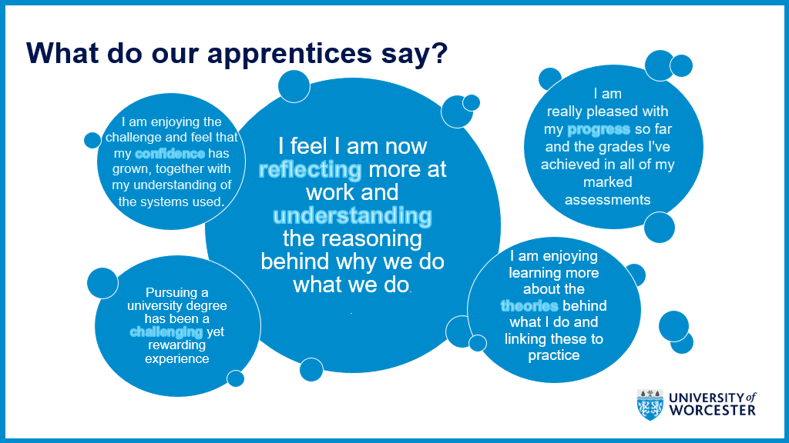


APHS Students highlight support provide
Notes:
“The Foundation Degree is such a valuable, well-recognised course and is a huge help.“
Claire, FD Graduate

Slide 15
FD Leaver Destinations (Graduate Employment & Further Study)
Jobs
Assistant Practitioner
Health and Social Care Lead
Community Support Worker
Dementia Adviser
Domestic Violence Officer
Duty Manager
Skills Trainer
Support Worker
Teaching Assistant
Pastoral Assistant Practitioner
Social Prescriber
Youth Work
Wellbeing Officer
Courses
Applied Health & Social Science (BA Top-up)
Children & Young People -(BA Top-up)
Diagnostic Radiography
Leadership & Management
Nursing
Occupational Therapy
Physiotherapy
Nutrition and Dietetics
(Source: Annual survey of destination of leavers from higher education)
Notes:
Statutory and voluntary sector organisations working with older people, families and people with disabilities
Advice and guidance services
Advocacy and social justice services
Social enterprise
Housing support services targeting young people
Community based provision and services
Health promotion services/ social prescribing
Welfare services
Care services

Slide 16
BA/BSc (Hons) Top-up Degrees Leaver Destinations
Jobs
Assessment and Enablement Officer
Assistant Clinical Practitioner
Corporate Graduate
Family Support Worker
Health Care Rehabilitation Worker
Mental Health Coordinator
Recruitment Consultant
Regional Manager
Residential Advisor
Support Worker
Young Persons Practitioner
Courses
MSc Healthcare Management and Leadership
BSc Nursing
MA Understanding Domestic and Sexual Violence
MSc Nutrition and Lifestyle Medicine
MA Social Work
MSc Psychology (Conversion)
MSc Occupational Therapy
MSc Physiotherapy
(Source: Annual survey of destination of leavers from higher education)

Slide 17

Current & Planned Engagement Initiatives
Enhanced Digital Presence
  The programme’s website was redesigned with inclusive language, updated imagery, and clearer educational pathways.
Professional Network Development
  A dedicated LinkedIn network supports alumni connections and boosts professional visibility in the sector.
Promotional Content Creation
  Upcoming videos will showcase student experiences, teaching activities, and practice environments.
Targeted Engagement Sessions
  Regular employer and applicant drop-in sessions facilitate collaboration and provide accessible support.
Notes:
A series of engagement and promotional initiatives are being implemented to strengthen visibility, recruitment and employer collaboration for the FDSc Assistant Practitioner and APHS Top‑up programmes.
Recent updates include the redesign of the programme’s web presence to incorporate refreshed health and social care imagery, inclusive language and clearer pathways, helping to broaden appeal to prospective learners from both health and social care backgrounds. The updated site also highlights the 2+2 progression pathway, enabling prospective students and employers to better understand how the FDSc leads into further study.
A dedicated LinkedIn network has been established to enhance professional visibility, foster alumni connections and support aspirational engagement with the broader sector. Looking forward, planned enhancements include the development of promotional videos to showcase student experience, teaching activities and practice environments, alongside the integration of an AP‑focused slide into Nursing and Allied Health Profession open‑day presentations to raise the profile of the Assistant Practitioner role. Additionally, targeted employer and applicant engagement is being expanded between February and May through regular drop‑in sessions.
These include two employer sessions per week and one applicant session, promoted to both existing partners and prospective collaborators. The sessions are facilitated by the apprenticeship lead and administrative officer, providing an accessible point of contact for enquiries relating to placements, apprenticeship expectations, role development and programme structure. Collectively, these initiatives strengthen the programme’s reach, improve understanding of the Assistant Practitioner role, and support employer confidence in the value of the FDSc and Top‑up routes. They also contribute to a more cohesive recruitment strategy by linking digital presence, direct engagement and cross‑school promotional activity.

Slide 18

Best part of the year: Graduation!

Slide 19

Contact Details:
FDAP:
Lisa Mauro-Bracken
l.mauro-bracken@worc.ac.uk
APHS:
Catriona Lennox
c.lennox@worc.ac.uk

