Slide 1

ICS Care Home Deterioration Pack
March 2026

Slide 2
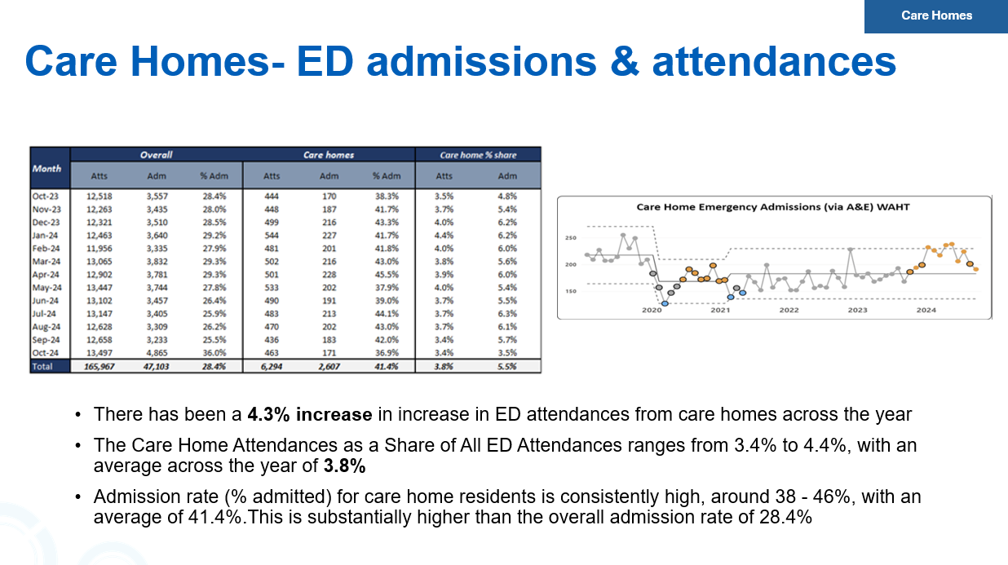
Background

Slide 3
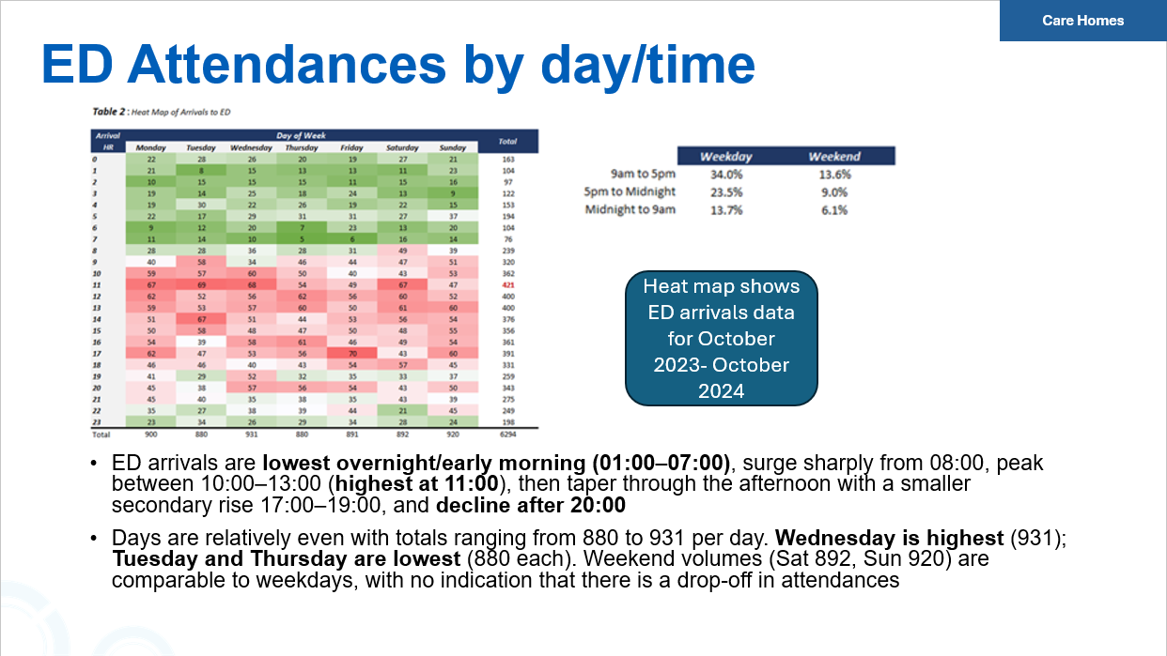

Slide 4
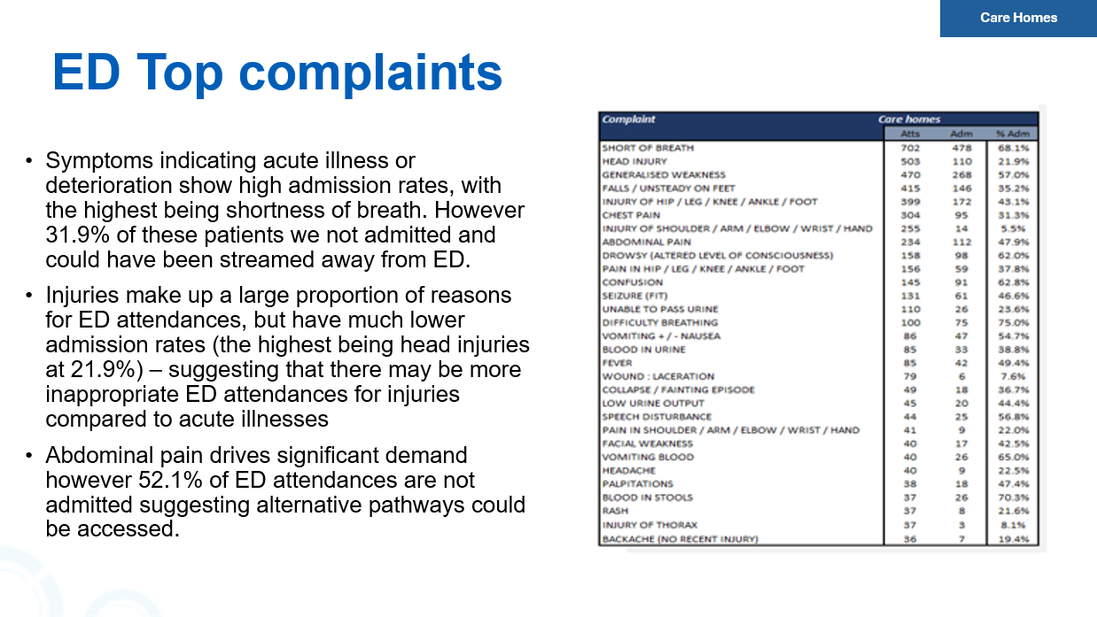

Slide 5
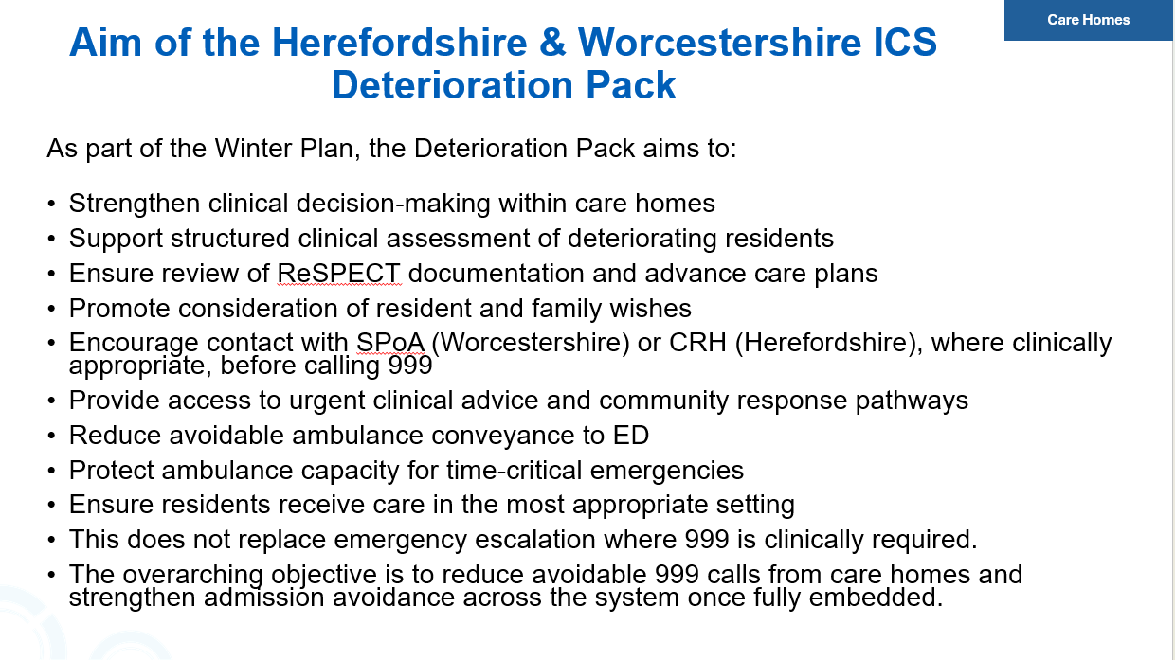

Slide 6
Purpose of the Deterioration Pack
The Right Care, in the Right Place, at the Right Time
This deterioration pack has been developed to support care home staff to:
Recognise early signs that a resident may be becoming unwell
Undertake structured clinical assessments
Escalate concerns safely and appropriately
Access urgent clinical advice through community services
Only access 999 services where clinically appropriately and in line with resident/family wishes
Ensure hospital admission occurs only where clinically appropriate

Slide 7
What Is Clinical Deterioration?
Deterioration means a change from a resident’s normal condition.
This may include:
Increased breathlessness
New confusion or agitation
Reduced mobility
Reduced oral intake
Changes in urine or bowel patterns
Fever or feeling cold/shivery
These are often referred to as “soft signs of deterioration.”

Slide 8
The PIER Framework
Managing deterioration follows the PIER framework:
Prevention – Supporting residents to stay well
Identification – Recognising early signs of deterioration
Escalation – Communicating concerns clearly
Response – Ensuring timely clinical review

Slide 9
Recognising Early Signs
Care home staff know their residents best.
Early recognition of deterioration can support:
Earlier clinical intervention
Improved outcomes for residents
Avoidance of unnecessary hospital admission
If something feels different from the resident’s usual condition, raise the alert and escalate concerns.

Slide 10
Escalating Clinical Concerns
Begin observations using ReSTORE2 approach
Review ReSPECT documentation
Escalate concerns using SBARD communication
This ensures clinicians receive clear, structured information to support decision making.

Slide 11
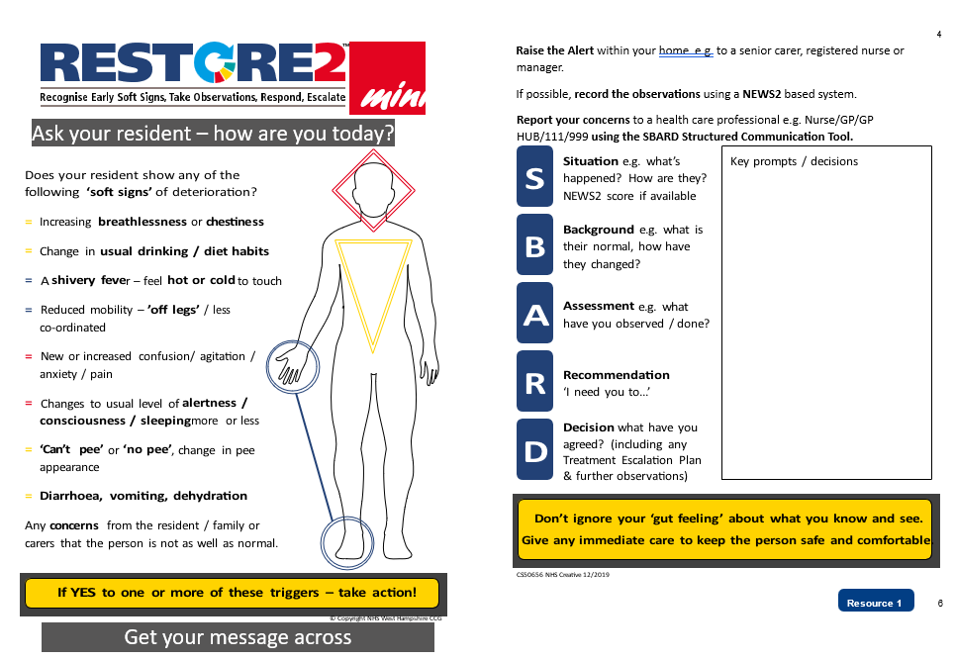

Slide 12
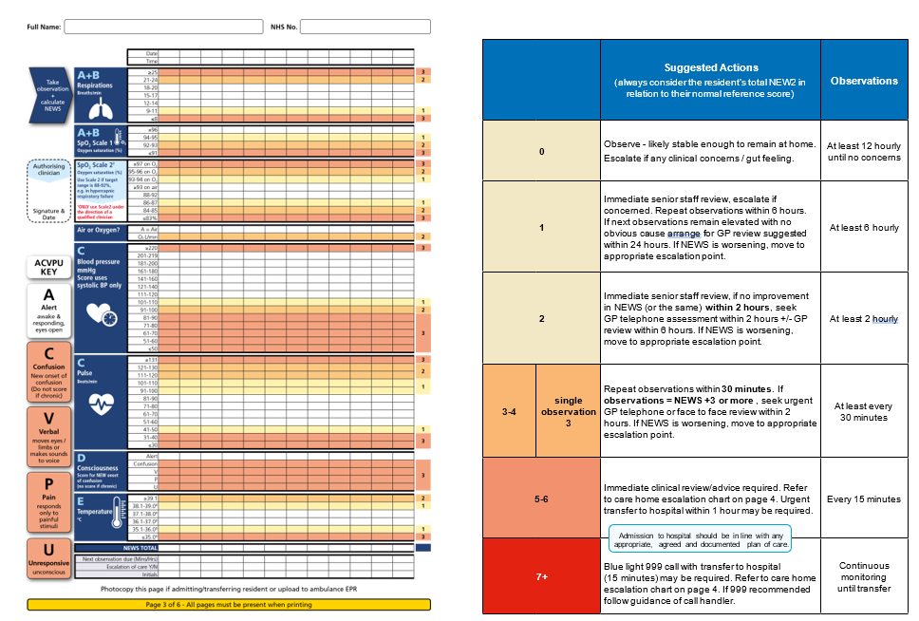

Slide 13
Core Escalation Principle
When a resident deteriorates, escalation decisions should always consider:
The clinical condition of the resident
ReSPECT documentation
Advance care plans
Resident wishes
Family views where appropriate
Emergency services should only be contacted where clinically appropriate and in line with ReSPECT documentation and resident wishes.

Slide 14
Patient Centred Decision Making
All escalation decisions should focus on:
✔ Resident safety ✔ Resident/Family wishes ✔ Clinical need ✔ Appropriate care setting
Many residents may receive more appropriate care within their care home environment, supported by community and primary health services.

Slide 15
Escalation Pathways
Care homes should escalate concerns using the most appropriate pathway:
PCN Teams
GP / Care Home Team
District Nursing
Other local Community Services
Single Point of Access (SPoA) and Community Referral Hub (CRH)
Urgent clinical advice
Rapid community assessment
Access to urgent care pathways
EoL Support
Emergency services may be required where clinically appropriate but must align with resident wishes and ReSPECT documentation.

Slide 16
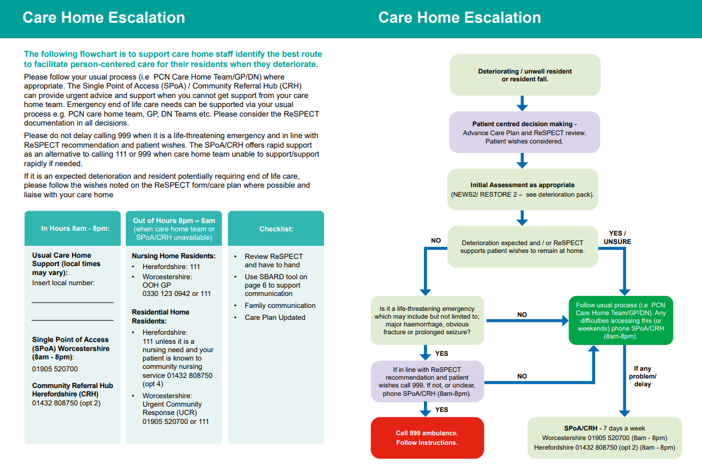

Slide 17
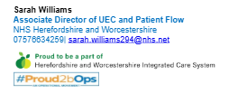
Additional Information
Governance process:
- Strategic Commissioning Committee (SCC)
- Clinical Assurance Sub Committee (CASC)
- Quality Impact Assessment (QIA)
Contact Information:

Slide 18
THANK YOU! ANY QUESTIONS?

