Slide 1
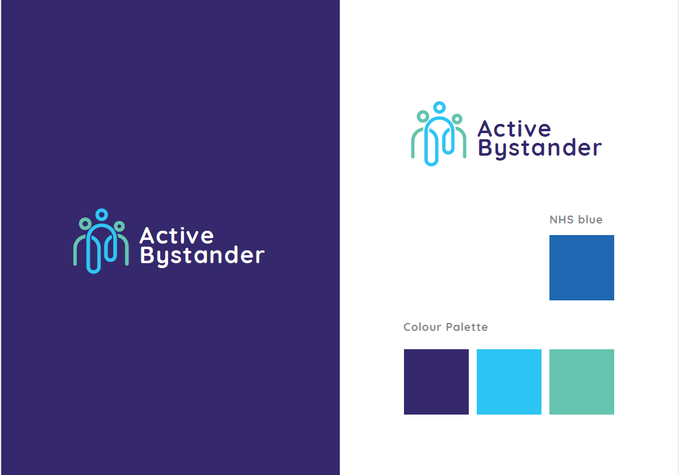

ACTIVE
BYSTANDER
Programme
ONE DAY WORKSHOP
Notes:
Edit slide to include your organisations image/logo and name
Room preparation and set up.
try to have materials ready for distribution during the session
check about fire alarms, rest rooms and any access aids with host/venue.
Set up IT equipment (turn of email/meeting alerts) check sound and links to videos
prepare register (with Pen) & name tags/labels

Slide 2
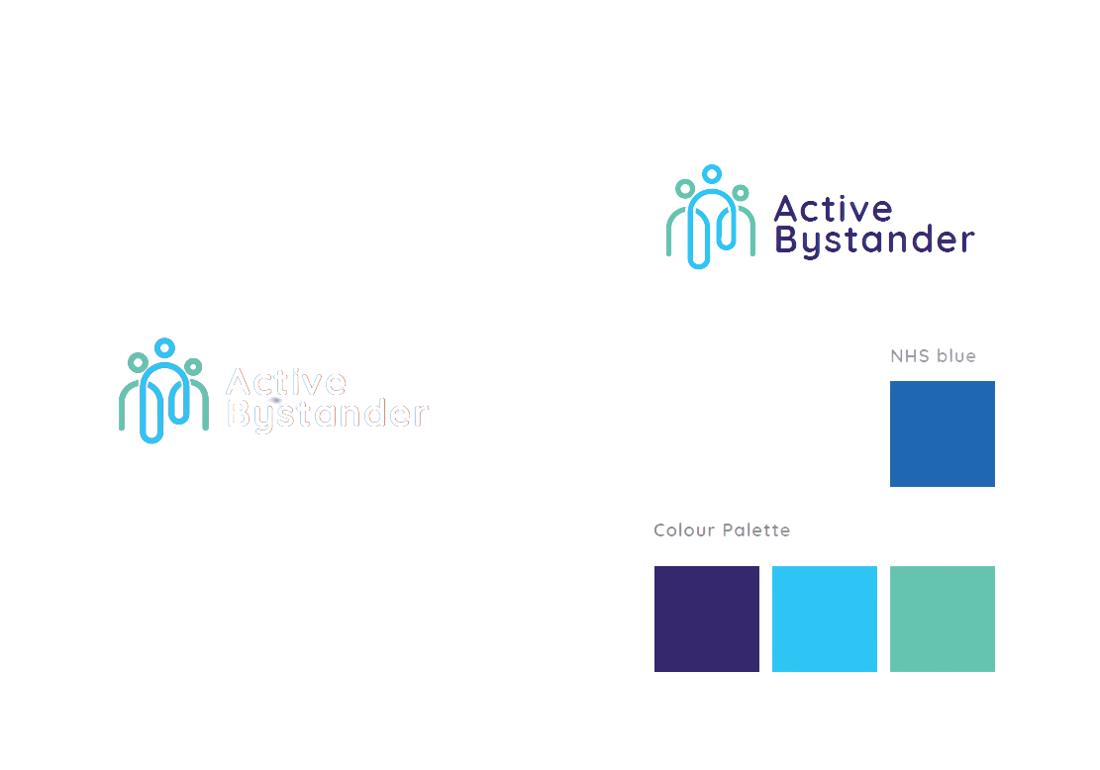
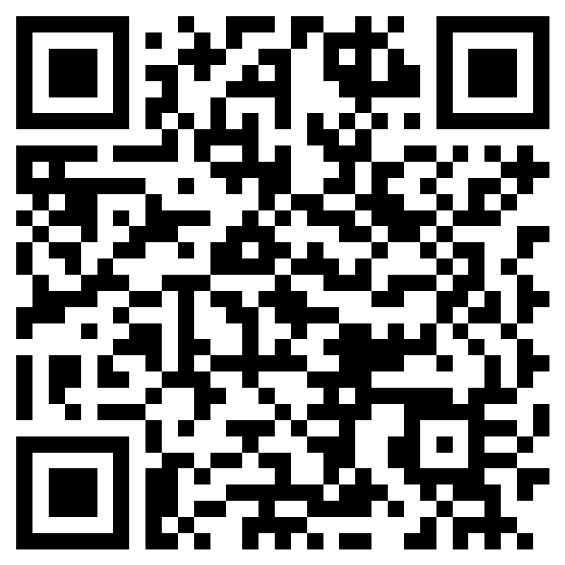
PRE WORK
Pre-Knowledge
Questionnaire
Scan me to complete
Notes:
These QR codes link people to the pre-work. You will need to edit this slide to insert QR codes for your organisations version of these questionnaires
Before Course starts delegates should have been sent and have completed:
1. Pre-session knowledge self-assessment
2. Moral Courage Survey
(have some printed in case people forget but direct them to the QR codes)
if they didnt have chance to complete prior to today then ask people to complete as the wait for the session to start
If people have completed in advance they dont need to do them again.

Slide 3
FACILITATORS FOR THE SESSION
Insert Image
Insert Image
HOUSEKEEPING
Insert Name
Insert Name
Programme Lead
Programme Lead
Notes:
Introduce yourself and settle people in with the "housekeeping"
House Keeping – cover fire alarms, toilets (make clear that people are free to take a break as and when they need), closest exit should some one wish to take their breaks outside (smoking etc).
Outline when breaks will happen and a time for people to expect to finish
Identify that we may take photos during the day and would like to take a group shot, if you’d prefer not to appear in any photos please let a facilitator know
Explain about phones and evaluation will need to get phones out periodically to take part in interactive data capture (may want to log into wifi – if possible),
Touch on social media and community of practice.

Slide 4

PROGRAMME OVERVIEW
The Active Bystander Programme was developed by the LLR Integrated Care Board’s LLR Academy team in 2022
The full programme was piloted across LLR’s Health and Care workforce
Today has been adapted for Hereford & Worcestershire ICS and is an adaptation of the LLR ICB’s 1.5 day ABP champion programme
Policies, processes and practices are not enough on their own to change behaviours and culture
The ABP promotes a positive proactive approach for early intervention which can prevent negative behaviours escalating
We aim to grow a community of practice, where we role model new norms for our working
environment
Notes:
This programme stems from the LLR ABP which was developed in 2022, was piloted in 22-23 and has become an award winning, system wide approach to actively addressing inappropriate behaviours by endorsing the role that active bystanders can play.
The programme aims to establish a proactive organisational culture approach to address harmful behaviours, promote an inclusive and compassionate culture, and role model our system values and expectations, making the system/organisation a great place to work and provide services for people who draw on our support.
we know that we need Active Bystanders – who place emphasis on improving confidence to identify harmful behaviours and intervene to de-escalate. Recognising that we might not always choose to intervene, we might not always get it right but we want people to seek to understand first, act with positive regard and encourage others to “call people in”, this way we are able to change hearts and minds conversation by conversation.

Slide 5
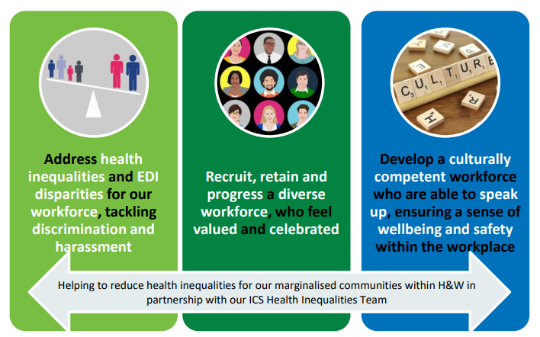
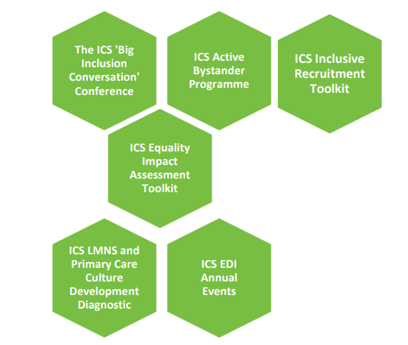
HW ICS CULTURE AND INCLUSION STRATEGY: MAKING INCLUSION A REALITY 2024-2029
Notes:
Insert your system/Organisations strategic plans
And talk about how the ABP sits within them

Slide 6
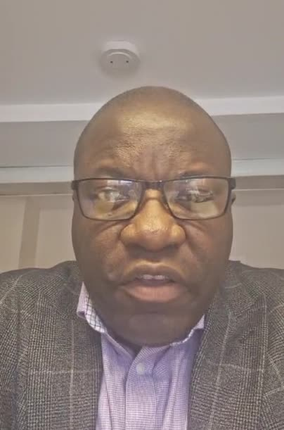
Geoffrey Etule,Chief People Officer, Wye Valley NHS Trust
An Introduction to the H&W Active Bystander Programme
Notes:
Insert your leaders video

Slide 7


VISION AND AIM
Vision
Aim
Our vision is to establish a proactive organisational culture approach to address harmful behaviours, promote an inclusive and compassionate culture, and role model our system values and expectations.
To deliver the Active Bystander development programme and establish an ‘Active Bystander’ community of practice supporting positive behaviour change for Hereford and Worcestershire.
Notes:
Vision & Aim and Programme outcomes - Our Vision is to establish a proactive organisational culture approach to address harmful behaviours, promote an inclusive and compassionate culture, and role model our system values and expectations, making the system/organisation a great place to work and provide services for people who draw on our support.

Slide 8
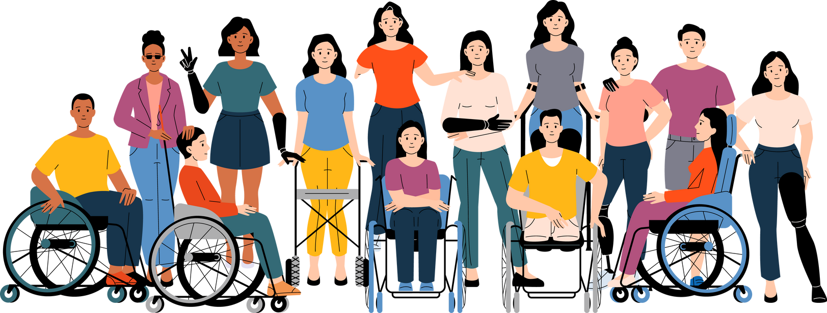
WHY DO WE NEED ACTIVE BYSTANDERS?
Active Bystanders don’t just stand by.
They make change happen conversation by conversation
Active Bystanders feel confident to identify harmful behaviours
They feel confident to intervene to deescalate situations
They feel part of a community wanting to make positive change
They work together to role model civil and respectful behaviours
They seek to understand first and act with positive regard for others
They on a learning journey and have a ‘growth mindset’ (where it is OK to make mistakes and learn)
Active Bystanders make a difference by de-escalating situations,
‘calling people in’ and considering appropriate ways to intervene
if it feels safe to do so
Notes:
Why do we need Active Bystanders
emphasise improving confidence to identify harmful behaviours and intervene to de-escalate.
Recognising that we might not always choose to intervene, we might not always get it right but we want people to seek to understand first, act with positive regard and encourage others to “call people in”, this way we are able to change hearts and minds conversation by conversation.
This will help to re-educate and ensure that we are emphasising the need to show empathy and seek to understand first.

Slide 9

GETTING TO KNOW YOU
Notes:
Getting to know you – share your name, location and job title (if you/they want) – then:
(choose either; what has motivated you to attend the ABP or something of the facilitators choosing to break the ice such as, a way to help others remember your name)
NOTE THIS NEEDS TO HAVE PACE and BE SWIFT.

Slide 10

OUR COMMITMENT TO EACH OTHER
Today is about us learning together
We ask that you uphold these shared principles
Treat each other with civility and respect
Uphold Confidentiality
Be Present
Be Brave and Honest
Be ready to Learn
Be comfortable with being uncomfortable
Make sure you have your needs met
Have Fun! Enjoy the journey together
Please be aware that we will be talking about sensitive issues and issues that might have affected you or people you care about.
Please do let a facilitator know if you need to access further support and use our signposting offer.
Notes:
Our commitment - Want to feel confident, comfortable and safe – taking yourself to the edge of your comfort zone and if you feel able, peaking over and pushing yourself to feel uncomfortable or “discomfortable”.
NOTE HERE IS A GOOD TIME TO MENTION THE NEED TO LISTEN AND NOT INTERRUPT COLEAGUES AS PART OF THIS COMMITMENT
(Can be cross referenced as session progresses if people need to be reminded as the day progresses)

Slide 11
Tell us one word to describe how you're feeling this morning?
Tell us about your hopes at the start of your Active Bystander journey
Tell us about your fears at the start of your Active Bystander journey
INSERT IMAGE OF SLIDO QR CODE AND SLIDO #NUMBER
OR
Use Microsoft Forms and insert QR code here

Slide 12



1.Drivers of
Inappropriate
Behaviours
OUR
JOURNEY
TODAY
2.Identifying Inappropriate
and
Unacceptable Behaviours
3.Why do
good people
behave badly?
4.Why do good
people not
intervene when
they see others behaving badly?
5.Active Bystander Strategies

Slide 13

1
MODULE
THE DRIVERS OF INAPPROPRIATE AND UNACCEPTABLE BEHAVIOURS
Notes:
This module starts by looking at “self” and approaching situations with positive regard for others, seek to understand and call people in (not out), re-educate and inform rather than embarrass.

Slide 14
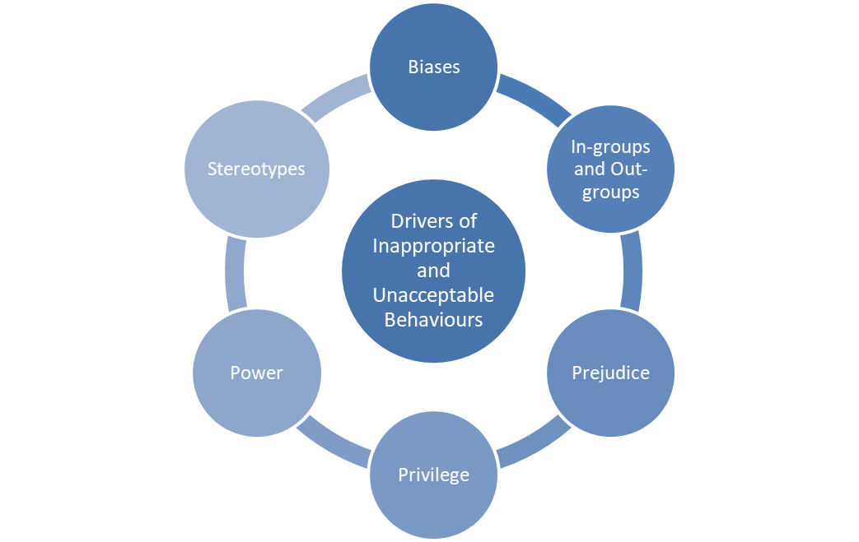
The Drivers of Inappropriate and Unacceptable Behaviours

Slide 15

WHY IS IT IMPORTANT?
To understand the impact of cultural norms
To understand ourselves and our own experience and to understand our potential to identify negative behaviours within cultural norms and to make the change
To help us better understand how we can shift the dial on negative cultural norms and effect behaviour change as active bystanders
Notes:
Starting with "self first" we want to take time to reflect, pause and consider what drives us, and those around us to behave or think in the way we do. This explores cultural norms and understands how we can help others to think more broadly be more considered and rather than jump in and call people out, consider other methods of possible intervention.
Reassure that we are on a learning journey together and want to inspire real cultural change – to do this we want to bring people in and develop/learn together

Slide 16
INGROUPS & OUTGROUPS
BIAS
PREJUDICE
Preferring or opposing a particular subject or thing.
Inclinations, prejudice, prejudice or tendency towards, or against, a person, group, idea or belief.
Biases are often based on stereotypes rather than knowledge or experience and are usually learned.
A negative action, emotion or behaviour towards individuals based on prejudgements about those individuals.
Prejudices are often learned or stem from little/no knowledege or experience
This is a form of group bias, where we categorise ourselves (and others) into groups;
those with whom we identify
those with whom we don't identify
Notes:
Biases - preferring or opposing a particular subject or thing
Sociologists identify biases to mean an inclination, prejudice, preference or tendency towards or against a person, group, thing, idea or belief.
Biases are usually unfair or prejudicial and are often based on stereotypes, rather than knowledge or experience. Bias is usually learned, although some biases may be innate.
There are 3 main components of bias formation they are:
1. categorisation,
2. Identification, and,
3. comparison.
4. (There is also unconscious bias and idolisation bias to consider)
Not only do we feel the need to categories ourselves and others but we identify with people who are ‘like us’ and we also compare people like us with people who are not like us.
Prejudice - Prejudice is a negative attitude, emotion, or behaviour toward individuals based on a prejudgment about those individuals with no prior knowledge or experience and/or a learned value or belief that causes a person to be biased for, or against, members of particular groups and/or commonly based on stereotyping.
Ancient prejudices are longstanding, deep rooted and historic prejudices for example anti-Semitism.
Modern prejudice is a term that reflects a shift from overt or explicit expressions of prejudice to more subtle, indirect, and covert expressions of prejudice, largely in response to shifts in social norms related to the acceptability of expressed prejudice
Ingroups and out groups - This is a form of ‘Group Bias’ in that we categorise ourselves (and others) into groups, identify with that group and compare that group to other groups. (see Bias definition)
In sociology and social psychology:
• an in-group is a social group to which a person psychologically identifies as being a member.
By contrast;
• an out-group is a social group with which an individual does not identify.
People have an inbuilt tendency to categorise themselves into one or more "in groups", building a part of their identity on the basis of membership of that group and enforcing boundaries with other groups to which they don’t belong “out groups”.
Social and familial influence can be a contributing factor to this, for example People may identify with their peer group, family, community, sports team, political party, gender, sexual orientation, race, religion, or nation.

Slide 17

PRIVILEGE EXERCISE
Notes:
Privilege
The dictionary definition focuses on “the power and advantage that only a small group of people have”
Privilege can extend to social groups and can relate to advantages associate to wealth, social class or other characteristic.
PRIVILEGE EXERCISE – marbles in the Jar. (an adaptation of the privilege walk)
see the presenters handout for full details and instructions
WARNING – please ensure that you read instructions in full and warn people that this exercise can feel uncomfortable or trigger people – its important to offer emotional support. A break or time to reflect is recommended after this exercise.
This exercise works best if you read through the questions and repeat each one once. The questions are open to interpretation and there is no right or wrong answer. Its best for participants to go with their initial instinct and gut and not over analyse (self-reflection opportunity will come at the end)

Slide 18
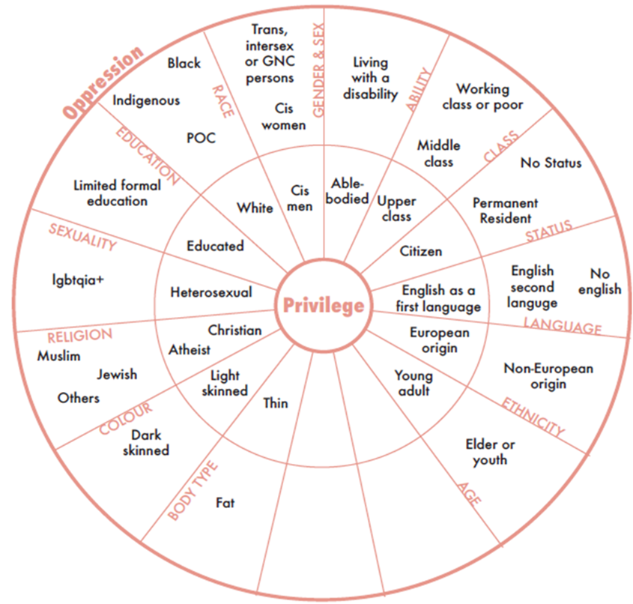
UNPACKING MY PRIVILEGE
What is Privilege?
“Privilege is defined as a social relation where one social group benefits at the expense of another. It is an unearned advantage and is often invisible to those who have it”
(Goodwill et al)
In many organisations powerful in-groups tend to confer certain privileges i.e. resources, opportunities, and support on those who deemed to be ‘like them’.
Source: https://twitter.com/jobusar/status/1324451695364055044
Notes:
Unpacking my privilege (hand out of the image is shared with delegate) – discussion around the overlap between power and privilege, and with the image on the slide, there are 2 blank segments, opens up for discussion about what what might be missing from the circle? (for example, home ownership, could have mortgage free property at the centre, then home owner with mortgage, then renting, with homelessness at the outside)

Slide 19
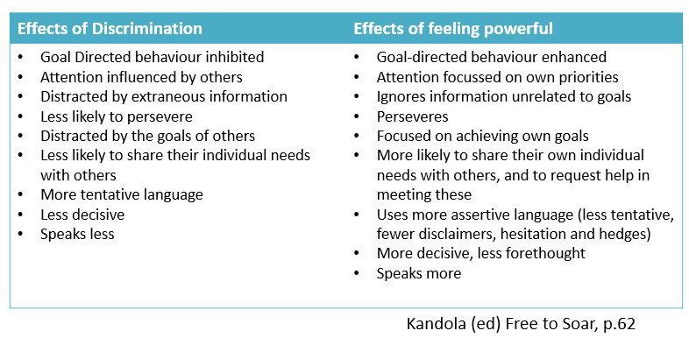
THE IMPACT OF POWER
Power is often linked to the sources of privilege.
These outcomes are often associated with discrimination and those who feel powerful
Notes:
Impact of power – this slide captures that a lack of power often aligns with feeling discriminated.
The way in which power is distributed throughout an organisation has a major impact on the organisations propensity to discriminate against individuals.
additional information:
Studies have identified 5 sources of power within an organisation have been identified as:
• Positional Power - Based on the individuals role within the organisation
• Reward Power -Based on an individual’s ability to influence others by providing something of value to them
• Coercive Power - Involves threats and or punishment to influence compliance
• Expert Power - Based on an individual’s knowledge and skills
• Referent Power - Based on individuals power relationship with others

Slide 20
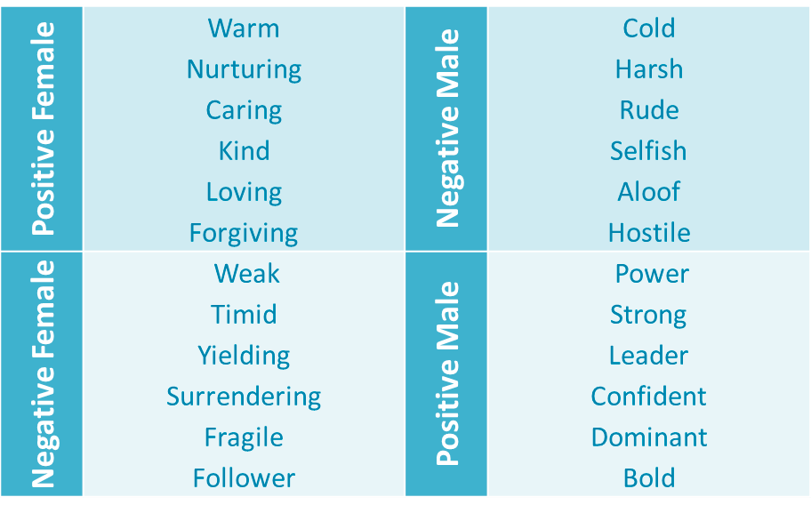
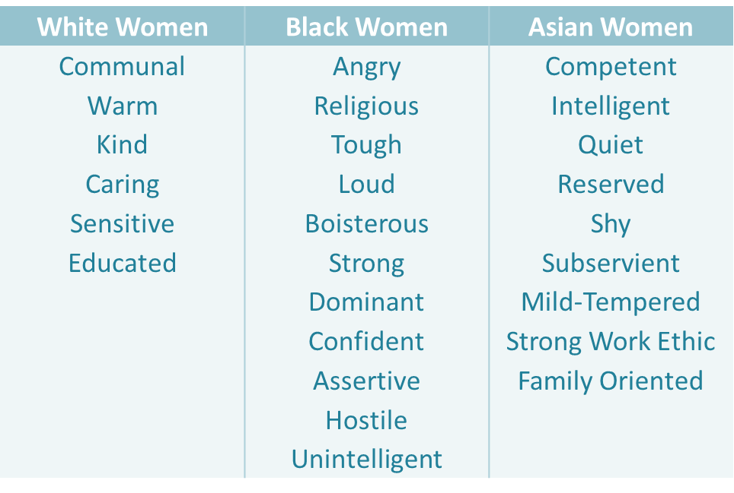
GENDER STEREOTYPING
Often Gender Stereotypes intersect with race
Gender Stereotypes
Source: Rudman, Greenwald, & McGhee and Kandola (2013)
Source: The Danger of Indifference: Racism at Work by Binna Kandola (2018)
Notes:
Stereotypes -
A stereotype can be defined as a “generalisation of beliefs about a group to its members that is unjustified because it reflects biased thought processes or over-generalisations, factual incorrectness, inordinate rigidity, misattributions, or rationalisation for prejudiced attitudes or discriminatory behaviours”.
Talk about each table – start to explore some elements of discomfort in talking about stereotypes and ask the group to reflect on the “classic” gender stereotypes that are shown on the slide (taken from work by Binna Kandola in 2013 & 2018)
Note the intersectionality when gender and race combine.
Make clear that this module is about looking at individuals and also yourself – take a look and reflect on who you are as an individual and then consider everyone – even in this room is a collection of individuals, we share some similar characteristics, behaviours and beliefs but we are all individuals – in the 3rd module we will explore groups and the collective of individuals. Looking at how this shapes and impacts on behaviours.
NOTE that Stereotypes discussion focuses on Race and stereotypes – this may also cause discomfort for members of the group and you should be aware of the need to take a break following this module.

Slide 21

BREAK

Slide 22
2
MODULE
IDENTIFYING INAPPROPRIATE AND UNACCEPTABLE BEHAVIOURS
Notes:
As we work through today’s session you will notice that we are starting with the theory first, building on understanding the drivers of inappropriate and unacceptable behaviour, understanding how those behaviours can, and do, manifest
and then,
• once we have a better understanding of the experiences of why people behave and respond in the way they do
• we can try to understand how we can encourage inclusive and cohesive working environments.
This module summarises some ways in which people treat others that are inappropriate and unacceptable.
They include...

Slide 23
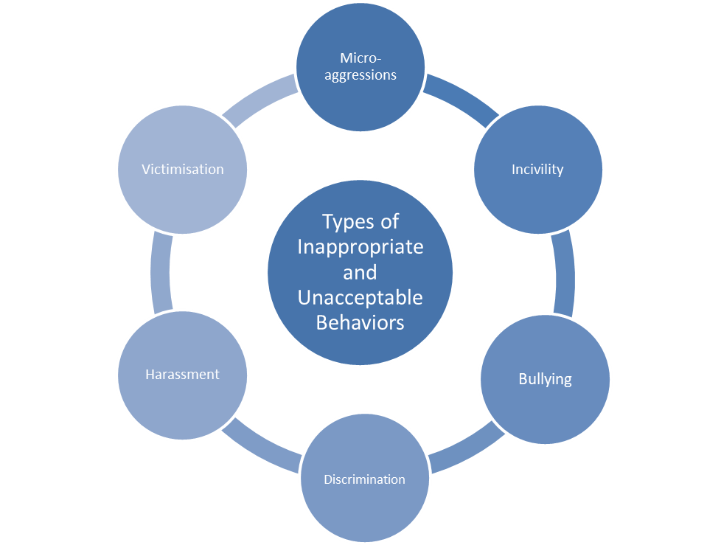
Types of Inappropriate and Unacceptable Behaviours
Notes:
We will explore the following types of inappropriate and unacceptable behaviours.
The majority of these types of behaviours have a legal definition but there is also a dictionary definition or a personal interpretation, which is often more generic, and equally valid so a key focus of this module is to remember that there is a human on the receiving end of these concepts and that people may feel harm or wrongdoing through another person’s actions, or inactions whether that meets the legal definition or not.
In other words, its not uncommon for people to feel discriminated against, victimised, bullied or harassed but, after an investigation, or grievance, organisations may conclude that there isn’t evidence to support such allegations, and the law, or local policies might not recognise behaviours as such but that does not make an individual’s perception any less important nor the impact any less damaging.

Slide 24
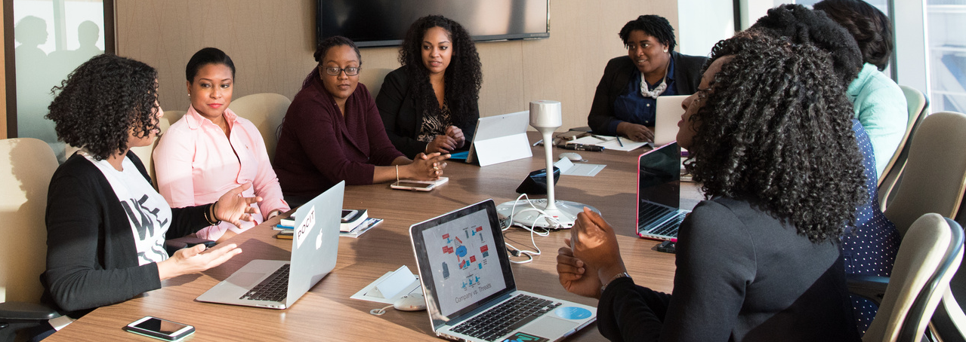

WHY IS THIS IMPORTANT?
Understanding some of the drivers of inappropriate and unacceptable behaviour, we are now focussing on understanding the actual behaviours
We need to understand this in order to intervene appropriately in different situations
Notes:
By developing a better and clearer understanding of what “bad”, harmful or unacceptable behaviour you should feel more confident to identify when a situation escalates, or reflect on the risks when counselling someone about a situation they have observed or been involved in.
Over time, allowing you to intervene and protect or support others – as an active bystander.
Another motivator for intervention in a work setting and being an active (not passive) bystander is to nip things in the bud to prevent them from escalating and damaging the team and those directly affected with the added impact of protecting the interests of your employer.

Slide 25

Micro-aggressions
COMMENTS, BEHAVIOURS OR ASPECTS OF AN ENVIRONMENT WHICH SIGNAL, INTENTIONALLY, OR UNINTENTIONALLY, THAT SOMEONE DOESN’T BELONG, OR THEY’RE NOT WELCOME
Adapted from source: Binna Kandola, 2019, https://pearnkandola.com/insights/how-micro-incivilities-can-impact-wellbeing/
Notes:
Micro-aggressions, also known as micro-incivilities, are:
Brief and often commonplace verbal, behavioural and environmental indignities, whether intentional or unintentional, which signal, that someone doesn’t belong, or they’re not welcome.
Often they communicate hostile, derogatory or negative slights, invalidations or insults to either an individual or a group because of their marginalised status in society.
The intent to harm can be ambiguous in these instances; sometimes blatant, other times more subtle. In addition to negative behaviours and attitudes it can also lead to people over-compensating and being too friendly.
Examples of micro-incivilities include:
• Being ignored
• Being talked over
• Having your authority undermined
• Being constantly criticised for seemingly small issues
• Having assumptions made about your honesty
• Body language (not facing a person, avoiding eye contact or not giving someone you attention)
The recipient of micro-incivilities often struggles longer and more deeply than if the aggression is more forthright and obvious, this is because the human response to the micro-aggression at time is often masked by confusion and doubt, then the individual will reflect and question the behaviour, often causing it to fester and last for longer. By dwelling and revisiting the aggression it can have a longer lasting and deeper impact on the individual which in turn has a deeper physical and emotional impact.

Slide 26

Notes:
Micro incivilities video:
Note down the micro-incivilities…. Or keep a tally
Share and discuss
NOTES/examples :
1. “manager” (M) has her back to a team member
2. M comments about the cold but doesn’t act herself leaving another to feel the need to rectify the situation
3. M hints that she is busy but others are not (Power)
4. M got a team members name wrong (has been doing for many months)
5. M doesn’t have time to read ‘trivial emails’ from within the team
6. Immediate response to those who enter late – she stands to attention and speaks with eye contact
7. 1 out of the 3 is late and looking at his watch – suggesting he feels he shouldn’t/doesn’t need to be there
8. Latecomer looks at team member and lifts eyebrows to indicate that he would like a seat
9. It seems to be the same person who has to give up his seat
10. 2 late comers talk over M
11. Looks between M and the late comers suggest power struggles
12. Latecomer constantly looking at his watch – indicating taking too much time and not important as he has somewhere else to be
13. Latecomer not engaging and listening to what is said by team member and completely changes the subject – more than once.
14. Leaves the person proposing the suggestion to feel deflated and under valued. Tone of voice and comments like “OK then, ill look into that”
15. Body language of parties in the meeting indicates whether they are engaged or deflated – will or wont contribute.
16. Suggestions just brushed under the carpet – dismissed
17. Latecomer steals the team members suggestion and spins it as being his own – doesn’t give the credit to the team member
18. “No more stress balls” appears to get a laugh from the dominant male in the room – indicating an “in joke” that not all are privy to.
19. Not putting phone on silent – taking the call – using this as an excuse to leave (without even saying goodbye)
20. Dominant male takes the departure of another to justify him leaving (although the meeting doesn’t feel over) – he stands and puts away his note pad – all symbolic that he has checked out and is no longer engaged.
21. Not being able to remember Ms name
22. Whispering and laughing – gives a feeling that being excluded and not part of the “in-group”
Group discussion to see who spots the most and what stood out to the group…
Closing reflections should remind people to start with themselves, think about their own micro-aggressions and how they can counter them by choosing kindness and opposing behaviours
The first tool to address inappropriate behaviours is to counter a micro aggression with a micro affirmation
Effective teams and organisations have been found to display various proactive, positive behaviours, or micro-affirmations.
These can include helping a colleague, conscientiousness, courtesy and positive body language. Without these, micro-incivilities can occur. Whether it’s withdrawal of help between colleagues, a lack of common courtesy or complaints about the behaviour of others, it can make for a hostile workplace environment.
Tiny acts of inclusion, caring and listening can keep teams motivated and on track by supporting relationships and shared goals. Without these behaviours across teams, friction can occur.

Slide 27
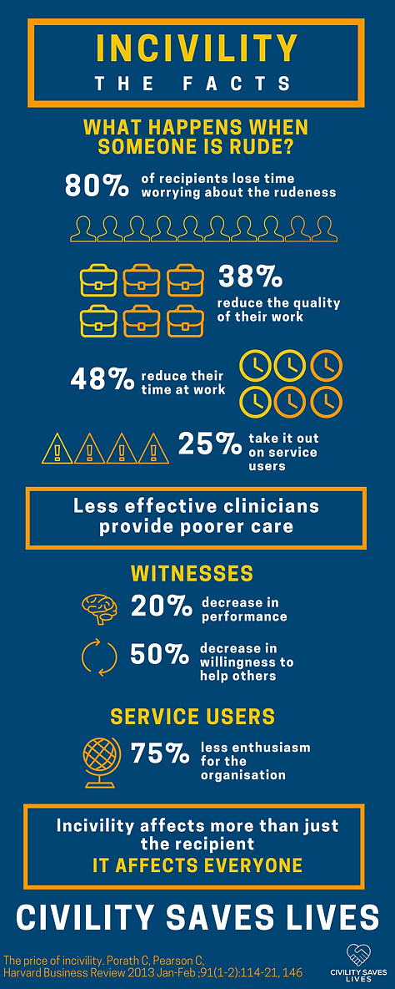

Incivility
“Incivility can be anything ranging from rude or unsociable speech or behaviour - Importantly, it is as interpreted by the recipient”
Source: www.civilitysaveslives.com
Notes:
Incivility can be anything ranging from rude or unsociable speech or behaviour - Importantly, it is as interpreted by the recipient”.
There are many examples:
• Shouting at someone,
• swearing,
• aggression (not necessarily towards someone),
• belittling someone,
• sending emails while in meetings,
• talking over others,
• being difficult over the phone,
• rolling eyes or tutting at someone”
(source Civility Saves Lives)
The Antidote to incivility = Civility
Why does this matter – its simple… Civil work environments matter because they reduce errors, reduce stress and foster excellence.
Almost all excellence in healthcare is dependent on teams, and teams work best when all members feel safe and have a voice.
Focus here is the importance of showing civility and respect from a patient safety perspective.
Uncivil behaviours can literally lead to patient safety issues on a sliding scale from loss of confidence in the treatment that a person receives all the way to loss of life.
Mention Chris Turner ED consultant who is part of the civility saves lives movement. He says “By choosing to act in ways which respects those around us we help individuals and teams to perform better” – recommend the ted talk which can be found on the civility saves lives website.
The Impact of Incivility
This impact has a direct impact on the recipient, and this has been measured in the office place by Christine Porath. She found:
​
- 61% reduction in cognitive ability
​
There were also many other impacts:
​ - 80% lose time worrying about the rudeness
- 78% reduced their commitment to work
- 63% lose time avoiding the offender
- 48% reduced their time at work
- 38% reduce the quality of their work
- 25% took it out on others, including customers
- 12% leave
Everything we do for our patients requires teamwork.
​
It may come as no surprise by now, that good teams perform better and this leads to better outcomes.
​
We often think about what makes a good team; clear roles, good communication, a shared vision or goal come to mind easily.
Rugby Scrum
But how often do we consider the team culture in that? Feeling valued and respected as part of the team - do these matter?
​
The New Zealand rugby team believes so, so they have a "no asshole rule" that reduces rudeness and individuals "being a d*ck", because when it is all about them, it's not about the team.
​
This is embedded in their team culture and has contributed to them becoming the most successful national rugby team in the world.
Volleyball Huddle
Why good teams matter in healthcare
The King's Fund Survey[1] identified numerous benefits from when staff perceived themselves to be in a good team:
​
- Reduced Hospital Standardised Mortality Rates
- Reduced patient complaints
- Improved staff satisfaction
- Improved staff performances
- Better reported health of staff
​
So when we are in a team which values and respects us, the benefits impact us and our patients.
Medical Team
In other words; good teams save lives.
This is where we start to think about incivility and the impact it has.
Dog in Cone
What is incivility?
Incivility can be anything ranging from rude or unsociable speech or behaviour.
​
Importantly, it is as interpreted by the recipient.
​
There are many examples:
​
Shouting at someone, swearing, aggression (not necessarily towards someone), belittling someone, sending emails while in meetings, talking over others, being difficult over the phone, rolling eyes or tutting at someone. The list goes on!
Thoughtful look
What happens when someone is rude?
When someone is rude to us, it reduces our bandwidth; our ability to effectively juggle multiple tasks and conscious thoughts.
​
For example, on a good day, we can actively juggle 6-8 things, like remembering to pick up the shopping on the way home, remembering the important birthday next week.
​
But this also includes tasks for our patients, like chasing the blood results, ordering investigations, being able to consider differential diagnoses.
​
Therefore, rudeness reduces our ability to do our jobs, until all we can focus on is them. They are actively making us worse.
Thinking Man
The Impact of Incivility
This impact has a direct impact on the recipient, and this has been measured in the office place by Christine Porath[2]. She found:
​
- 61% reduction in cognitive ability
​
There were also many other impacts:
​
- 80% lose time worrying about the rudeness
- 78% reduced their commitment to work
- 63% lose time avoiding the offender
- 48% reduced their time at work
- 38% reduce the quality of their work
- 25% took it out on others, including

Slide 28

Types of Inappropriate and Unacceptable Behaviours
BULLYING
Unwanted behaviour from a person or group that is:
offensive, intimidating, malicious or insulting OR an abuse or misuse of power that undermines, humiliates, or causes physical or emotional harm to someone.
VICTIMISATION
The law defines victimisation as "subjecting a person to detriment because they have;
brought proceedings,
given evidence or
made an allegation
under the Equality Act 2010"
DISCRIMINATION
The law defines two forms of discrimination, direct and indirect;
Direct discrimination is less favourable treatment because of a protected characteristic.
Indirect discrimination is where a provision, criterion or practice has a disproportionate and adverse impact on a group who share a protected characteristic
HARASSMENT
The law defines harassment as;
"unwanted conduct related to a protected characteristic which has the purpose or effect of violating a person's dignity or creating an intimidating, hostile, degrading, humiliating or offensive environment"
Notes:
Bullying = There is no legal definition of bullying, there is a dictionary definition, which makes reference to Power (as we have already identified on many occasions today):
Dictionary definition - the behaviour of a person who hurts or frightens someone smaller or less powerful, often forcing that person to do something they do not want to do
Then there is the ACAS definition (Advisory, Conciliation and Arbitration Service):
“unwanted behaviour from a person or group that is either:
• offensive, intimidating, malicious or insulting
• an abuse or misuse of power that undermines, humiliates, or causes physical or emotional harm to someone"
ACAS identify that bullying might:
• be a regular pattern of behaviour or a one-off incident
• happen face-to-face, on social media, in emails or calls
• happen at work or in other work-related situations
• not always be obvious or noticed by others
Examples of bullying at work could include:
• spreading malicious rumours about someone
• consistently putting someone down in meetings
• deliberately giving someone a heavier workload than everyone else
• excluding someone from team social events
• someone consistently undermining their manager's authority
• putting humiliating, offensive or threatening comments or photos on social media
(ACAS are the authority in UK employment and HR matters. They are an independent public body that receives funding from the government to provide free and impartial advice to employers, employees and their representatives )
Discrimination = Discrimination can take the form of ‘Direct’ or ‘Indirect discrimination’. These are identified and defined in The Equality Act 2010.
Direct Discrimination occurs when “a person treats another less favourably than they treat, or would treat, others because of a protected characteristic.”
Breaking this into bite sized elements;
Discrimination occurs where there is less favourable treatment, BECAUSE of a protected characteristic
Less favourable treatment
Covers any disadvantage, often the way to establish less favourable treatment is to flip this on its head and question whether the person would have been treated:
• Differently and
• More favourably
“but for” their sex, race, religion or believe, sexual orientation, disability, age, gender reassignment or marital/civil partnership. This requires an actual or hypothetical comparator and an analysis of why the treatment occurred.
There are 9 Protected Characteristics:
• age
• disability
• gender reassignment
• marriage and civil partnership
• pregnancy and maternity
• race
• religion or belief
• sex
• sexual orientation
For example: Jon isn't offered a promotion because he has depression. But his colleague Harry, who doesn't have depression, is offered a promotion – even though he has less experience and fewer qualifications.
Indirect Discrimination occurs when “a person (or employer) applies a provision, criterion or practice (PCP) which is discriminatory in relation to a relevant protected characteristic of another. AND the PCP puts, or would put, the person who shares the characteristic at a particular disadvantage when compared with persons who do not share that characteristic AND it cannot be shown that the provision, criterion or practice is a proportionate means of achieving a legitimate aim.”
This breaks down in to its component parts:
• a person (or employer) applies a provision, criterion or practice (PCP) which is discriminatory in relation to a relevant protected characteristic of another.
• the PCP puts, or would put, the person who shares the characteristic at a particular disadvantage when compared with persons who do not share that characteristic
• the treatment is not a proportionate means of achieving a legitimate aim (the justification defence)
Indirect discrimination occurs where
1. a person belonging to a particular protected group.
2. Is put at a disadvantage which affects that protected group
3. Due to a provision, criteria or practice that is apparently neutral (if obviously disadvantageous the claim is more likely to be one of direct discrimination!)
AND
4. The PCP cannot be justified as being a proportionate means of achieving a legitimate aim.
For example in the finance department they will only conduct interviews for new recruits in person, and on the second floor of a building which can only be accessed by climbing 2 flights of stairs. This practice puts people with a physical disability at a disadvantage because they wouldn't be able to access the building.
See next slide for harassment and victimisation notes...

Slide 29

REFLECTION EXERCISE
Discuss one of the types of behaviour within your group.
Consider...
1. What these behaviours look like
2. How they impact on people at work
Feed back to the whole group the key points from your discussion
Notes:
Harassment =
a person harasses another if they engage in unwanted conduct related to a relevant protected characteristic AND that conduct;
• violates the others dignity, or
• creates an intimidating, hostile, degrading, humiliating or offensive environment for that other person.
Sexual Harassment is separately defined in legislation and is said to occur when a person “engages in unwanted conduct of a sexual nature” (unwelcome sexual advances) AND the conduct has the purpose or effect [that it]:
• violates the others dignity, or
• creates an intimidating, hostile, degrading, humiliating or offensive environment for that other person.
There is a third and finally form of legally defined harassment which occurs where a person is subjected to less favourable treatment because they submit to, or reject sexual harassment or harassment related to sex or gender reassignment which has the purpose or effect of creating an intimidating, hostile, degrading, humiliating or offensive environment for the complainant or violating the complainants dignity.
NOTE ABOUT HARASSMENT… changes to law around sexual harassment
The Worker Protection (Amendment of Equality Act 2010) Act 2023, which came into force on 26 October 2024, amends the Equality Act 2010 in two respects:
1. Introduces a new duty on employers to take reasonable steps to prevent sexual harassment of their employees. This marks a key change in focus in the legislation from redress to prevention, imposing a new obligation on employers to be proactive in tackling sexual harassment; and
2. Gives employment tribunals the power to uplift sexual harassment compensation by up to 25% where an employer is found to have breached this new duty – this uplift could be significant, especially as compensation awarded in the most serious cases of sexual harassment can exceed £50,000.
Victimisation =
Section 27 of the Equality Act 2010 defines victimisation as:
a person victimises another if they subject that individual to a detriment because they have, intend to, or believe that they may have, brought proceedings under the Equality Act OR gives evidence or other information in connection with proceedings under the Equality Act OR makes an allegation that a person (or employer) has contravened the provisions of the Equality Act.
This means that a person can bring a claim for victimisation if they are subject to a detriment because one of the following applies:
• They have, intend to, or believe that they may have, brought proceedings under the Equality Act
• They give evidence or other information in connection with proceedings under the Equality Act, OR,
• They make an allegation that a person (or employer) has contravened the provisions of the Equality Act.
IMPORTANT
Dictionary definition - the act of victimizing someone (treating them unfairly)
This is probably the widest difference between the legal and general understanding of what people understand when they use identify that they have been victimised. The 2 ends of the spectrum between the legal definition and personal perception are significant.
Often people feel victimised, because they feel attacked or singled out – this is not really comparable to the legal definition, which requires affiliation with a claim under the equality act and that in turn must correlate to a protected characteristic.

Slide 30

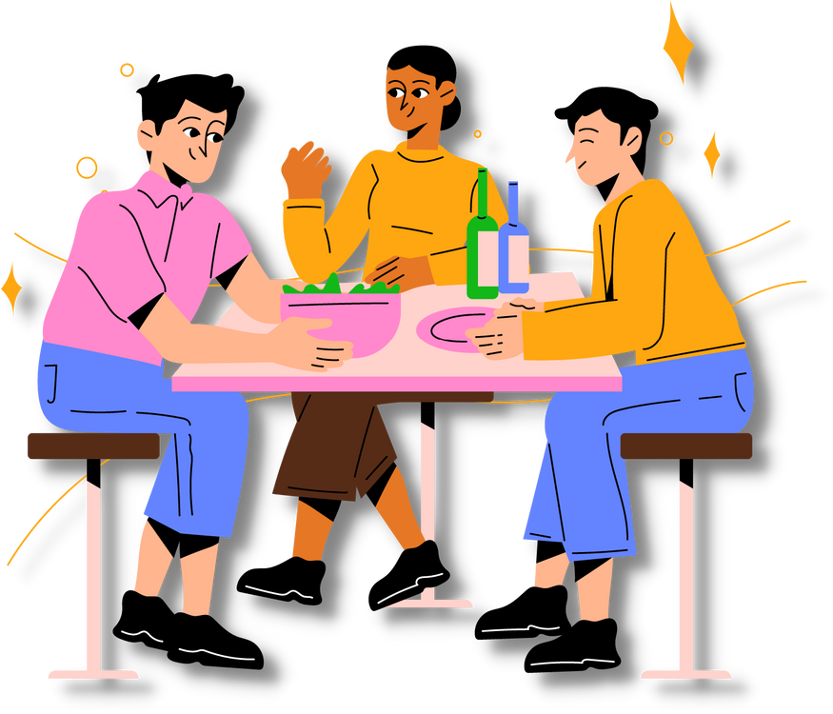
LUNCH

Slide 31

3
MODULE
Why do good people behave badly?
Notes:
In this module we focus on Professor Catherine Sandersons work (Professor of Life Sciences (Psychology) at Amherst College in the United States. Sanderson has published over 25 journal articles and book chapters in addition to books on parenting and on how mindset influences happiness, health, and even how long we live (The Positive Shift). Her latest book, “Why We Act: Turning Bystanders Into Moral Rebels”, examines why good people so often stay silent or do nothing in the face of wrongdoing.)
o The Hazard of the Herd
o Just Following Orders
o A Question of Identity
o The Agony of Indecision
o Gradual Escalation

Slide 32
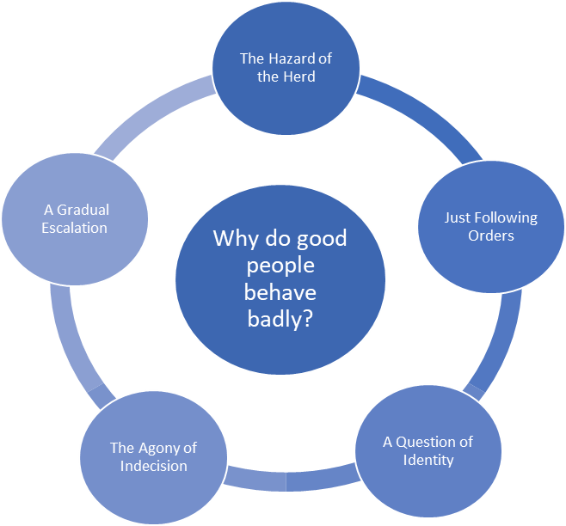
Why do good people behave badly?

Slide 33
WHY IS THIS IMPORTANT?
We want to cultivate a civil and respectful working environment.
Role model an attitude of 'seek to understand' first and 'positive regard' for others.
This attitude helps to grow a psychologically safe environment for colleagues to work together, constructively challenge each other and learn together.
This enables us to shift the dial and change cultural norms.
People are more likely to listen and change their behaviour from a place where they feel safe.
It is not about 'being nice' and making excuses for harmful behaviours.
Notes:
Others are more likely to role model the behaviours that they see, they are influenced by the actions of others – This is down to the basic instinct of survival, and wanting to fit in.
This helps us to understand why good people behave badly but is also the start of our journey of exploration about how to be an active bystander – if your eyes are open to what is happening and why it might be happening then perhaps you can switch your own responses and behave in the way you want to be treated or you wish others would have treated you.
In this module you are encouraged to stop and question why we work in certain ways and try to take a fresh look at a situation that you have always just accepted then we can work together to shift the cultural dial. Keep in mind that having positive regard for others doesn’t mean you are excusing the behaviour, but if you can help them to understand what is happening, and explore why its happening then hopefully you can re-educate and encourage change.
Nip bad behaviours in the bud – “fail well to succeed sooner”
Create psychologically safe environments – encourage honesty, mistakes are OK and human nature. Display vulnerability and others will become more open and honest themselves
Positive intent, positive regard for others and calling people in rather than calling them out.

Slide 34
Descriptions
HAZARD OF THE HERD
The notion that people will do things in a group that they would never do on their own.
JUST FOLLOWING ORDERS
People are often more willing to follow the instructions of an authority figure especially in situations where the authority figure exudes a willingness to assume responsibility for any negative outcomes as this allows the person who is engaging in the bad behaviour to feel absolved of wrong-doing.
A QUESTION OF IDENTITY
People who ‘are just following orders’ tend to identify with the person who is giving the orders, and in this instance, they may become willing actors in poor behaviour.
THE AGONY OF INDECISION
This occurs when people who are given orders by an authority figure which they know may cause harm decide to disobey these orders. The journey to disobedience is however, sometimes fraught with anxiety and hesitation.
A GRADUAL ESCALATION
People find themselves in a situation which slowly builds and causes more harm as it progresses. In such circumstances it is often hard to recognise the problem(s) and then harder still to disengage and step away early from the process.
Source: Catherine Sanderson, The Bystander Effect, 2020
Notes:
Hazard of the Herd
The theory: that people will do things in a group that they would never do on their own.
Examples include:
• In July 2024, a stabbing at a dance workshop in Southport, Merseyside, left three young girls dead and ten injured. Widespread misinformation about the attacker on social media, falsely labelled him a Muslim migrant. This fuelled anti-immigration riots across England and Northern Ireland, leading to violence, arson, and looting.
Just Following Orders
The theory: People are more likely to follow instructions from an authority figure, especially when the authority assumes responsibility for any negative consequences. Often resulting in individuals feeling less accountable for their actions, even if they involve bad behaviour.
Examples include:
• Business Executives engaging in Corporate Fraud – ENRON (USA), BHS, and Patisserie Valarie
• Nazi Germany – The “Just following orders defence” became known as the Nuremberg defence when many Nazi generals and senior figures gave “just following orders” as justification for their crimes
A Question of Identity
The theory: People who ‘are just following orders’ tend to identify with the person who is giving the orders, and in this instance they may become willing actors in poor behaviour.
Examples include:
The US Storming of Capitol Hill is referred to as “Trump mob mentality”, where a charismatic leader (in this case a powerful president) told a large group of his supporters to 'fight like hell,' they listened and fed off each other.
The Agony of Indecision
The theory: This occurs when people who are given orders by an authority figure which they know may cause harm decide to disobey these orders.
It is human nature to deliberate and evaluate, some people find it easier than others to be decisive but in almost all case, when you are given instructions, it is difficult to be disobedient.
Often the decision to disobey is fraught with anxiety and indecision.
Disobedience can take many forms and may result in several attempts at early intervention, with a wide variety of strategies being deployed
A Gradual Escalation
The theory: people find themselves in a situation which slowly builds and causes more harm as it progresses. In such circumstances it is often hard to recognise the problem(s) and then harder still to disengage and step away early from the process.
Examples include:
Story of the Boiling Frog:
Explain the parody of the boiling Frog – people don’t notice subtle changes in environment and can become complicit rather than identifying that it is boiling and jump out immediately before bad things can happen.
Frogs are amphibian (land animals that breed in water) they are also cold blooded.
If you put a frog in a pan of boiling water – it will jump out
BUT
If you put a frog in a pan of cold water they should be comfortable and at home, if you add heat and gradually turn up the gas, they may notice it getting warmer (or not) but they will adjust, even bask in the warmth, and before they realise the temperature is too hot and they don’t have the energy to escape – eventually they would boil – all because they were unaware and didn’t notice the slow and subtle changes.

Slide 35
REFLECTION EXERCISE
PERSONAL EXPERIENCE
THE HAZARD OF THE HERD
‘JUST FOLLOWING ORDERS’
A QUESTION OF IDENTITY
THE AGONY OF INDECISION
A GRADUAL ESCALATION
Think of a real life example where good people behaved badly
Share with the group
Discuss whether one of these reasons might explain why people behaved the way that they did
Notes:
EXERCISE – use the description cards (each of these theories explained) and split into groups/tables. Take time to discuss real life scenarios that you have witnessed or experienced
Could these theories help to explain those situations, discuss and then feed back to the room.
Expected learning = 1 or more theories contribute, its unlikely that tables will decide exclusively that just 1 applies

Slide 36

4
MODULE
WHY DO GOOD PEOPLE NOT INTERVENE WHEN THEY SEE OTHER PEOPLE BEHAVING BADLY?
Notes:
“Bad things happen when good people do nothing”.
Many world famous quotes talk about the crippling impact on victims where no one was upstanding in support of them when they suffered injustice. This emphasises the importance of enabling those who feel confident and able to feel able to take a stand for the benefit of others who don’t have the confidence in their own voice.

Slide 37

What might stop you from intervening when you witness harmful behaviours at work
INSERT IMAGE OF SLIDO QR CODE AND SLIDO #NUMBER
Notes:
Ask what stops delegates from intervening when they witness harmful behaviours at work?
(share to see what people say and how that compares with the evidence based responses of our thought leaders)

Slide 38
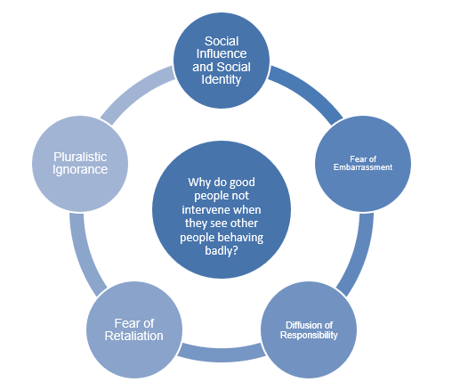
Why do good people not intervene when they see other people behaving badly?

Slide 39
WHY IS THIS IMPORTANT?
We want to understand the barriers to people intervening when they see inappropriate behaviours.
We want to reflect on our own reasons for not intervening or for stepping forward and intervening in different contexts.
It helps to assess why others are not intervening and for us to consciously decide to be an Active Bystander.
However, being an Active Bystander does not mean you will always step forward and intervene in every situation.
We want to understand when it is psychologically and physically safe to intervene.
This knowledge and understanding enables us to 'read the room' and make decisions in the moment.
Notes:
If we can understand what prevents others from stepping in, and consider why we have/haven’t in the past then we can better understand what might make us better active bystanders.
It doesn’t mean that it is always safe, appropriate or right for you. And on a case-by-case basis you can weigh up whether its right to get involved, how you might choose to get involved and make the best decision for you, and those around you, in any moment or situation.

Slide 40
Descriptions
SOCIAL INFLUENCE AND SOCIAL IDENTITY
“It looks like something is wrong, but I don’t see anyone else doing anything, so maybe it’s not so bad after all.”
FEAR OF EMBARASSMENT
“If I react or get involved, it might call negative attention to me or embarrass the person I’m trying to help.”
DIFFUSION OF RESPONSIBILITY
“There’s got to be someone who’s more qualified than me to handle this, so I’ll wait and let them do it.”
FEAR OF RETALIATION
“I don’t want them to start picking on me next!”
PLURALISTIC IGNORANCE
“This is the way we’ve always done things, and no one’s speaking up, so everyone else must think this is the best way to handle it.”
Source: Catherine Sanderson, The Bystander Effect, 2020
Notes:
Social Influence and social identity
social psychology theory - no one else is doing anything so I shouldn’t either often this also links to not feeling a connection to the victim.
Example – the monthly fire alarm. At 10:00 on the first Wednesday of the month the fire alarm sounds. What do we all do? We look around, whats everyone else doing, is anyone worried, anyone getting up – if not we sit through and carry on regardless.
Fear of embarrassment
The anxiety of not knowing how others will respond to your intervention, getting the intervention wrong or being judged for your intervention often prevents people from acting
Diffusion of Responsibility
Assume someone else will intervene-‘The Bystander Effect’
When people believe someone else will step in, then sometimes no-one steps in.
Again, there is a group/social influence element to this, if you are 1 person witnessing an incident you may feel 100% responsible for whether to respond or react – however if there are 4 additional witnesses then you may only feel 20% responsible. The responsibility becomes defused or dispersed among the group members. In these situations, people may assume that someone else will help or that someone else is better qualified to provide assistance.
But if everyone assumes this, then no one will intervene.
Fear of Retaliation
physical harm, others’ reactions, professional and personal impact
Pluralistic Ignorance
Pluralistic ignorance is where individuals underestimate others’ internal beliefs and believe they are in the minority when actually they are in the majority. (I.e. nobody else thinks this behaviour is wrong) This is important in a bystander context because it means they are less likely to act.
For example, imagine you are at the local swimming pool and you see a child splashing wildly in the water. Your first instinct would probably be to look around you and see how others are responding. If others appear shocked and are yelling for help, you may conclude that the child is drowning and dive in to help. But, if those around you are ignoring the child or laughing, you may conclude that they child is just playing around.
To avoid looking foolish, you would probably just continue watching and would fail to dive in and help. This seems like a reasonable approach and for the most part, it prevents us from making a fool out of ourselves.
But the problem is that this tendency to look to others in order to determine how to respond can be biased by a phenomenon known as pluralistic ignorance. Pluralistic ignorance describes a situation where a majority of group members privately believe one thing, but assume (incorrectly) that most others believe the opposite.
Could mention the “smoke experiment” - Darley and Latane's classic study, saw participants complete a questionnaire and after a few minutes, smoke started to pour into the room underneath a door in the back.
• Some participants were the only one in the room when this happened,
• but for others, there were two other students completing questionnaires in the room as well. (In actuality, these two "students" were working for the researchers and were instructed to keep calm not matter what happens.)
The key question in this study was would the participant notice the smoke and go get help or would they simply write it off as nothing concerning and continue working on their questionnaire.
• The result showed that when the participant was alone, 75% of them left to report the smoke.
• But when there were two other people in the room who remained calm, only 10% left to get help. In some cases, the smoke got so thick the participant could barely read the questionnaire in front of them! Yet, as long as their fellow bystanders remained in calm, they did as well.
Thus, when we are alone, we are more likely to assume an ambiguous situation represents and emergency and act accordingly. When we are in the presence of other bystanders, we are likely to look to those others for guidance and if they are not responding or are laughing or are taking photos of the event, we will mistakenly conclude it is not an emergency and will fail to help.

Slide 41


“What hurts the victim most is not the cruelty of the oppressor, but the silence of the bystander”
Eliezer “Elie” Wiesel. Author, Professor, Political Activist and Holocaust survivor

Slide 42
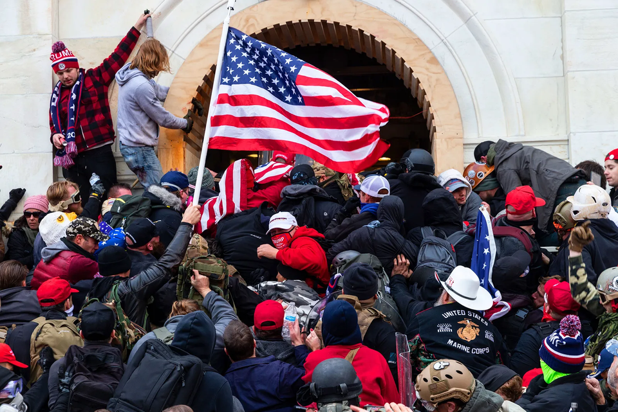

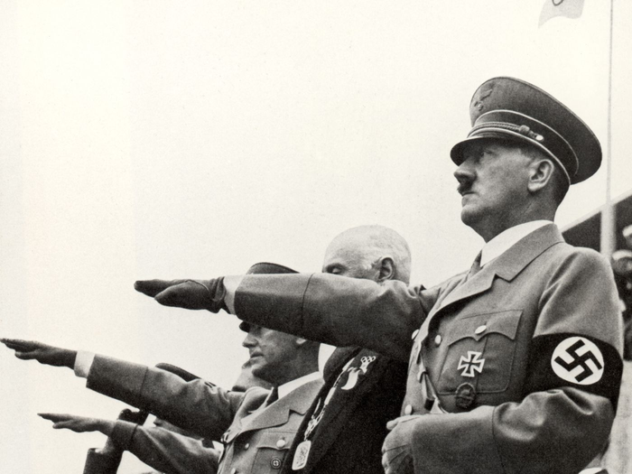
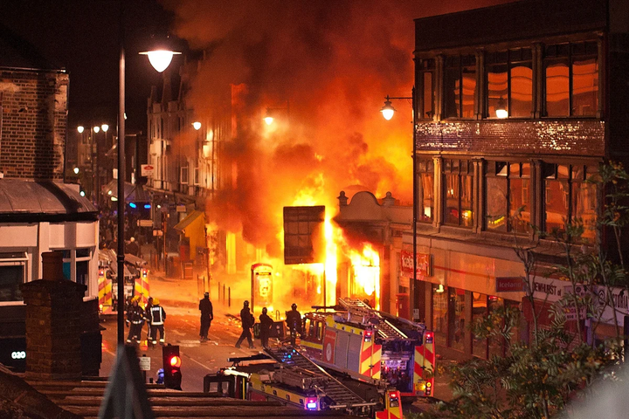


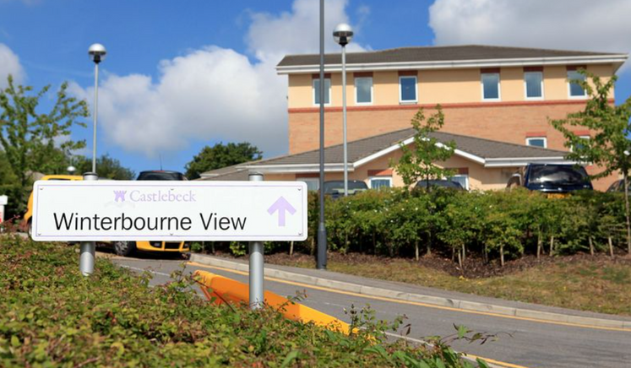
REFLECTIONS ON THESE EVENTS
Notes:
The Post Office pursued thousands of innocent subpostmasters for apparent financial shortfalls caused by faults in Horizon, an accounting software system developed by Fujitsu
Between 1999 and 2015, more than 900 subpostmasters were convicted of theft, fraud and false accounting based on faulty Horizon data.
Other subpostmasters were prosecuted but not convicted, forced to cover shortfalls caused by Horizon with their own money, or had their contracts terminated.
London Riots: The 2011 England riots, more widely known as the London riots, were a series of riots between 6 and 11 August 2011. Thousands of people rioted in cities and towns across England, which saw looting, arson, as well as mass deployment of police and the deaths of five people. The Catalyst was the Police Shooting of an unarmed black man Mark Duggan in Tottnham Hale. Violence and unrest spread throughout London over the course of a few days and other Cities in the UK saw “copy cat” events in Manchester, Birmingham, Bristol, Leicester and Derby.
Nazi Germany was the German state between 1933 and 1945, when Adolf Hitler and the Nazi Party controlled the country, transforming it into a dictatorship. Under Hitler's rule, Germany quickly became a totalitarian state where nearly all aspects of life were controlled by the government. 1933
Social Media Trends: Delegates may have their own examples to share, with current news stories and events that can be brought into the conversation as examples.
A couple of examples that could be considered:
• 2014 The Ice Bucket Challenge – started in the US to raise money for Amyotrophic Lateral Sclerosis (ALS) also known as motor neuron disease or Lou Gehrig's disease. The challenge was to throw a bucket of ice-cold water over one’s head and then nominate people to do the same within 24 hours. The Ice Bucket Challenge raised over $220M worldwide and facebook had more than 2.4 million tagged videos.
• The ‘Tik Tok Effect’ - Tik Tok is a video sharing app that actively promotes the creation of video ‘Trends’ and for many of us we think of popular dance trends or maybe even during Covid lockdowns the BookTok posts.
Winterbourne View (2012): What happened? Adults with learning disabilities and autism living at Winterbourne View hospital were subjected to systematic abuse by members of staff. Most adults living at the hospital were detained under the Mental Health Act 1983. It led to the Government pledge to move all people with learning disabilities and/or autism inappropriately placed in such institutions into community care by June this year. Another recent panorama was released where similar incidents had occurred amongst staff.
On the 6th Jan 2021 a crowd numbered between 2,000 and 2,500 people gathered at Capitol Hill. It contained members of far-right groups such as the Proud Boys and the Oath Keepers. Many were carrying weapons. They sought to keep Trump in power by preventing a joint session of Congress from counting the electoral college votes to formalize the victory of President-elect Joe Biden.
Following an hour long speech by the then president Donald Trump, Hundreds of people forced their way into the building through windows and doors, overwhelming the Capitol police.
In his speech Trump indicated that "If you don't fight like hell, you're not going to have a country anymore”. In the hour that he spoke he used 22 references to the word, or similar words meaning “fight”.

Slide 43
WHAT WOULD YOU DO?
Reflect on the historical and current news events Slide
Individual: write down your perspective/ reasons why you would intervene OR not intervene in these situations.
Groups: look at what you listed as reasons & discuss
You do not have to share your reflections if you do not feel comfortable, but you can consider the general reasons from the cards for your table discussion.
Notes:
What would you do? - Reflect on the historical and current news events Slide. Work in pairs or as tables:
• Individual: write down your perspective/ reasons why you would intervene OR not intervene in these situations (5 minutes).
• Groups: look at what you listed as reasons & discuss

Slide 44
Why We need Psychological Safety at work and how this impacts on the climate to freely speak up as Active Bystanders
The importance of Psychological Safety | Amy Edmondson
The King's Fund(2020)
Notes:
WATCH - Amy Edmundson – Psychological safety video
Reinforce moral courage – when it is safe to intervene and that there are various methods, forms and degrees of intervention – anything is great but sometimes nothing is best.

Slide 45


1.Drivers of
Inappropriate
Behaviours
What stands
out from this material
for you?
2.Identifying Inappropriate
and
Unacceptable Behaviours
3.Why do
good people
behave badly?
REFLECTIONS
4.Why do good
people not
intervene when
they see others behaving badly?
How could you
use this in
your workplace?

Slide 46

5
MODULE
ACTIVE BYSTANDER STRATEGIES

Slide 47
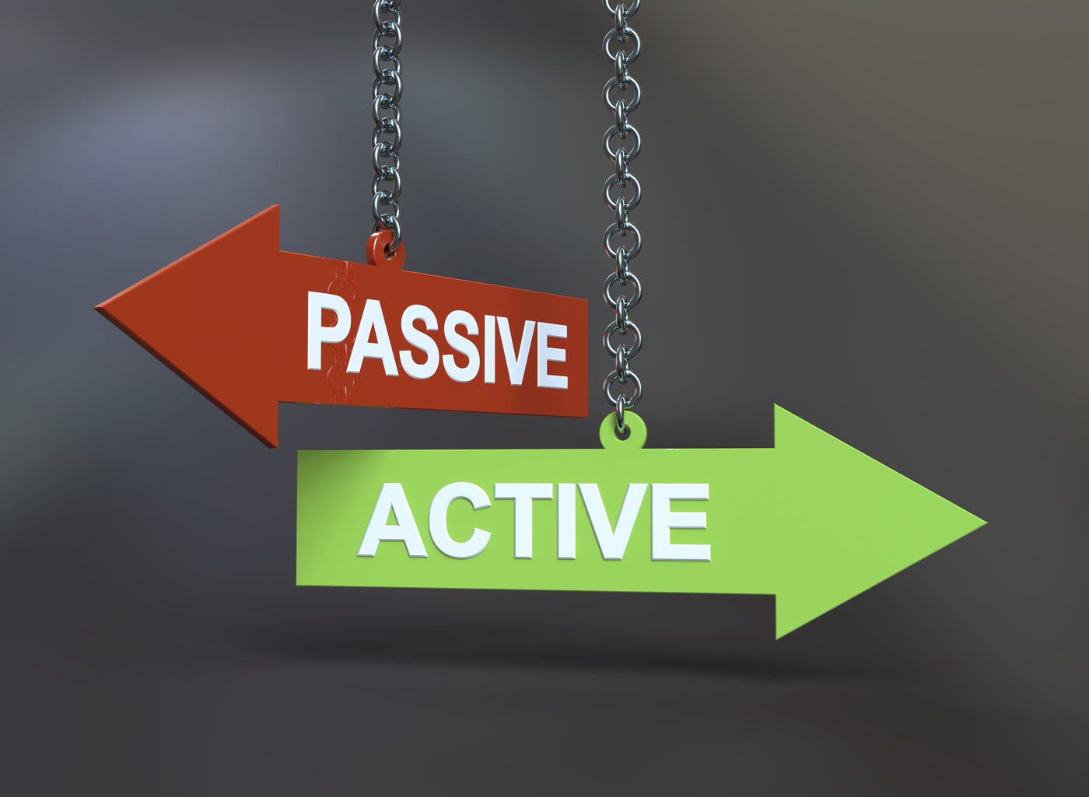


Becoming an 'Active' Bystander?
A Bystander is a person who is standing near and watching something that is happening but is not taking part in it
Cambridge Dictionary
An Active Bystander is someone who intervenes when they observe and identify harmful behaviour being displayed by others.
An Active Bystander is not just a witness to an act, they take action and intervene when it is safe to do so.
Notes:
Who is an Active Bystander?
Who is an active bystander?
A Bystander is a person who is standing near and watching something that is happening but is not taking part in it.
An Active Bystander is someone who intervenes when they observe and identify harmful behaviour being displayed by others. They are not just a witness to an act, they take action and intervene when it is safe to do so.
Active Bystanders need to have moral courage. Psychologists describe people who display moral courage as 'moral rebels' and "People who take a principled stand against the status quo.
[Introduce the concept of Moral Rebels (we will return to this in a few slides)]

Slide 48




Moral Courage and Moral Rebels
Psychologists describe people who display moral courage as 'moral rebels'. As "People who take a principled stand against the status quo"
Moral Rebels
Are confident their actions will make a difference
Have little concern about fitting in with the crowd
Are not afraid to speak up in support of their beliefs and values
Feel confident about their own judgements, values and ability
High
self-esteem
Moral
Rebel
Sanderson (2020)
Notes:
Moral Courage and Moral Rebels = Active Bystander Attributes:
Having the courage to stand up against social influence, pressures and all of the factors that we have discussed up until this point and rebel against those social pressures that push us towards silence.
This might be:
• Confronting a colleague when you see or hear something inappropriate
• Challenge a persons hostile/intimidating/unwelcome conduct or behaviour
• Call someone out for their micro-aggression or kill them with kindness and deliver micro affirmations
Moral rebels:
• Are confident their actions will make a difference
• Have little concern about fitting in with the crowd
• Are not afraid to speak up in support of their beliefs and values

Slide 49
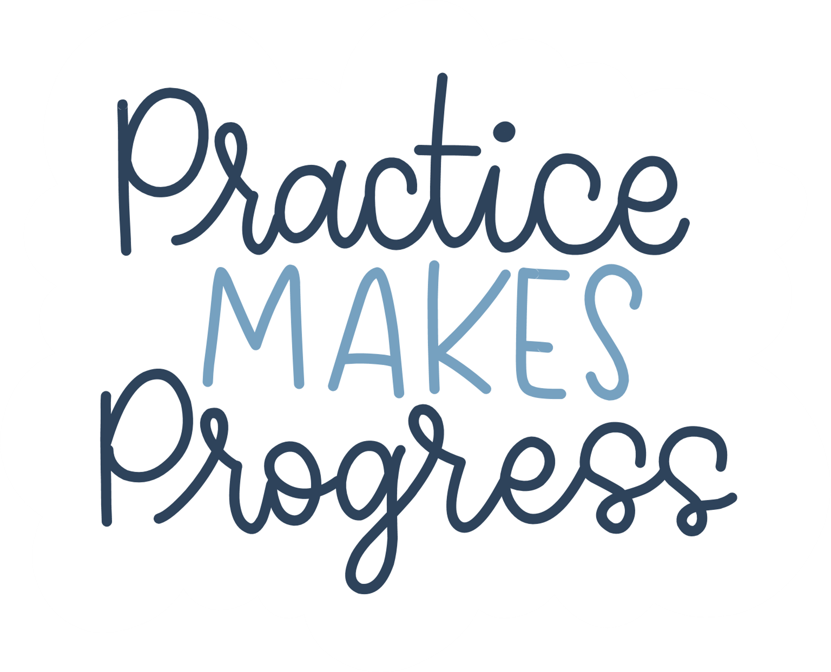
Finding Your Inner Moral Rebel
Not all of us are natural 'moral rebels' but that does not mean we cannot become active bystanders.
It is possible to develop the ability to stand up to social pressure and we can learn how to become moral rebels by practicing
How?
It helps to see others role modelling moral courage
It helps to develop and practice skills in moral courage
It helps to develop our ability to feel empathy for others e.g. spending time with and getting to know people from different backgrounds, ethnic, religious, political, and cultures helps us to imagine the world from someone else's perspective
Believe in Change! The more people who speak up the greater the potential for change.
Sanderson (2020)
Notes:
Find your inner moral rebel:
Catherine Sanderson has suggested that only 10% of the populations are innate moral rebels – however that doesn’t mean you can’t become one or learn the ways in which to be one:
• Observe others role modelling moral courage
• develop and practice some of the skills of moral courage
• develop our ability to feel empathy for others e.g. spending time with and getting to know people from different backgrounds, ethnic, religious, political, and cultures helps us to imagine the world from someone else's perspective
• Believe in Change! The more people who speak up the greater the potential for change.

Slide 50

UNDERSTANDING ‘INTERVENTION’
“The action of becoming intentionally involved in a difficult situation, in order to improve it, or prevent it from getting worse”
(Cambridge Dictionary)
4 STAGES OF ‘INTERVENTION’
Possess the necessary skills to deal with it
Interpret it as a problem
Feel responsible for dealing with it
Notice the event
Direct OR Indirect and you can intervene before, during or after an event
Source: https://www.health.columbia.edu/services/bystander-intervention-step-0; Four stages to becoming a prosocial bystander (Adapted from Berkowitz, 2009, p10)
Notes:
The four stages:
1st – notice an event
2nd – identify it as a problem
3rd – feel responsible for dealing with it
Finally – possess the necessary skills to deal with it …
REMINDER OF The Golden Rule – Only intervene when it is safe to do so

Slide 51
Golden Rule
Only Intervene when it is safe to do so
Intervention comes in many forms -
it is often absolutely possible to make safe, unthreatening interventions that don't involve putting yourself in physical danger, and sometimes the best way to intervene is to wait for a better opportunity, to get in touch with a professional who can handle things safely.
Adapted from The Scottish Intervention Initiative, University of Strathclyde

Slide 52
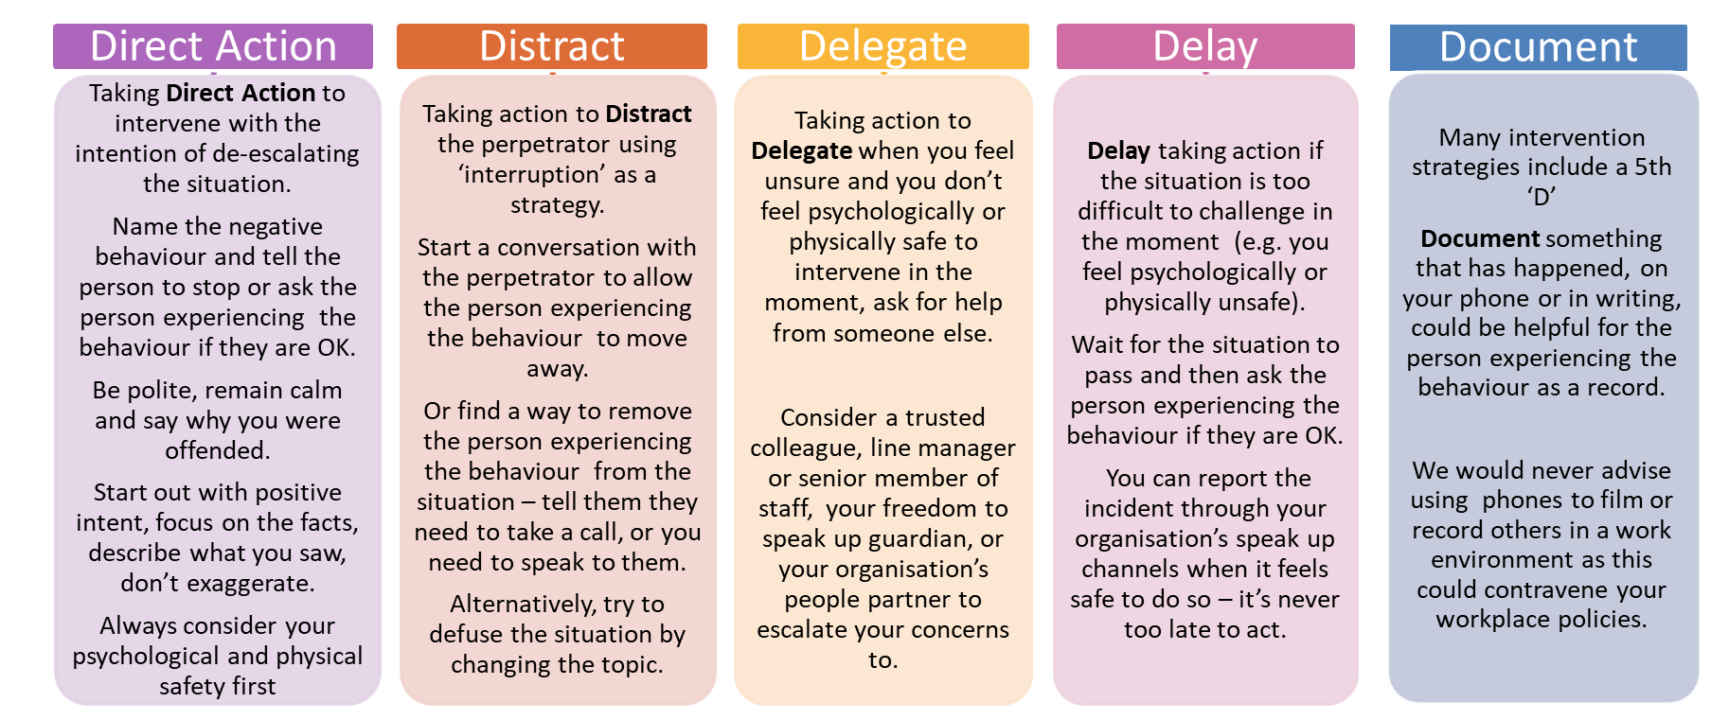
THE FIVE D'S
In an Emergency, call the police on 999
Never put yourself in danger. Only intervene if safe to do so.
Source: Adapted from the University of Cambridge’s ‘Be an Active Bystander’ 4 D’s model, and based on the work of ‘Right to Be’
Notes:
Talk through the examples on the slide – these are key principles and messages, but its important to remember that different people will come to an intervention with different perspectives, different learned experiences and different preferences.
Encourage delegates to keep in mind "Delay", as this gives the option to check in with the person experiencing the behaviour, you will always have the option to “Do Something”.
No two people are the same so try to reinforce the following:
Different people have different preferences
Different situations come with different contexts
Your “role” in any situation will impact how you choose to respond. For example, if you are the victim you may choose delay and document. But, if you are a witness, you may be in a position to choose direct or delegate.
The 5 D’s
Direct action = intervention in the moment, with a view to either improve the situation, or prevent it from getting worse (see intervention definition) – we want you to remain calm and stay safe. If possible remember to “call-in” and encourage people to understand the perspectives of other people as this will help to defuse rather than inflame the situation.
Distract = using interruption to take attention away from what's happening. You might distract the perpetrator, the “victim” or the whole situation with a view to diverting the focus on the negative behaviour. Various options may be available (depending on the circumstances – for example, if you are in a public place you could ask one party to help you with another task, or if you are in a meeting, you could turn back to the agenda and focus attention to another subject)
Delegate = ask someone else to help. This might be someone more senior, a peer, or someone else who is external to the situation for help (like F2SU or HR)
Delay = pause. Then, after the event, check in with the parties – ask the “victim” if they are OK” – This is always a way to be an active bystander and “do something”
Document = Make a written note of what has happened – this may be a personal note or perhaps a summary which you write in an email and send to an appropriate person (for example a line manager, or someone who reasonably ought to be made aware) – unlike in some Bystander intervention material, we do not endorse video or audio recordings as this will likely contravene your internal policies).
FACILITATOR NOTE – in preparation for this section you might choose to share a personal example or you could choose to share a previously discussed example.
Examples may include:
In a situation where a colleague is in a team meeting and someone talks over them, shuts their opinions down or disregards their contribution you might choose to take direct action by identifying that your colleague has something they wanted to share and encourage them to share it. Or, you could wait until after the meeting, check in with the colleague to see how they are, and note that you saw what happened. Alternatively, you might try to understand more about the situation and, if you feel able, raise this with the persons line manager, or the chair person of the meeting. This may lead to you ask the chair to reiterate the Terms of reference on the next occasion that you get together and encourage contributions from the wider group. You may confirm this conversation via email (thereby documenting the intervention)
OR, Imagine that you are present in a team discussion during an away day and a group of colleagues are laughing and joking about the catering, which didn’t include any vegetarian options and resulted in a member of the team having to leave the session during a break to buy their own lunch (because for religious reasons, they often choose to eat the vegetarian options at a buffet). This makes you feel uncomfortable because you are aware of the impact this has, and if your colleague heard this, they would likely feel uncomfortable (this behaviour could amount to harassment). You might not feel comfortable to name the behaviour, and explain its impact, instead, you might choose to change the conversation away from this point or raise your concerns with someone more senior and ask them to speak with the individuals.

Slide 53

Helpful Tips
Think about body language - calm and non-confrontational
You can show disapproval
(e.g. non-verbal with silent stare)
Distraction
Humour (use with care!)
Use “I” statements
Encourage eliciting empathy
Use compassion as a framework
Use social norms
Suggested reading
Prof Catherine Sanderson’s ‘6 Tips’ for Speaking Up
Adapted from The Intervention Initiative, UWE, Bristol

Slide 54
Intervention Phrases
Delegate
Ask someone else to step in
OR
encourage others to step in by saying 'I can't be the only one thinking this is not ok?
Empathy:
I hope no-one ever talks to you like that
'How would you feel if someone said/did that to you?'
Direct:
Tell the perpetrator to stop
OR
Ask the person experiencing the behaviour if they are ok
Distract
Use interruption
Ask to speak to the person experiencing the behaviour
Use 'I' statements in 3 parts
I (1) state your feelings (2) name the behaviour (3)state how you want the person to respond
Empathy:
I hope no-one ever talks to you like that
'How would you feel if someone said/did that to you?'
Think about what strategies/phrases you might use to intervene safely in a situation you've witnessed if you were to go back in time and intervene?
Adapted from various sources: including The Intervention Initiative, UWE, Bristol; Breaking the Silence, Cambridge University
Notes:
Intervention phrases/techniques (hand out):
Exercise Working in pairs – take 5 minutes to work through and consider “your authentic voice” – what phrases could you use, do you like, could “borrow” from those in the room today – consider some intervention strategies and take aways:

Slide 55

AFTERNOON BREAK

Slide 56
SCENARIO EXERCISE
Notes:
Split into groups of 3 – as a group take on a role of either:
1. Person experiencing the behaviour/Victim
2. Perpetrator
3. Active Bystander
Take on the role of your chosen "person" as you watch the video.
Think about how you feel, what's happening for you and what you think should/could happen next

Slide 57
SCENARIO EXERCISE
Decide who will take the role of:
Person experiencing behaviour
Perpetrator
Active Bystander

Slide 58
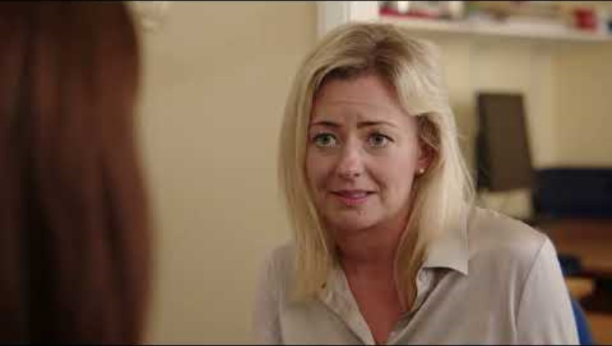
Scenario 1

Slide 59
SCENARIO EXERCISE
How did it feel in the role of:
Person experiencing behaviour
Perpetrator
Active Bystander
Which of the 5 D strategies could you have used?
What might you have done, or said?
Notes:
Also think about:
1. What was the inappropriate behaviour?
2. What could the drivers of the inappropriate behaviour be?
3. Why did those “good” people behave “badly?
4. Who else could have intervened? (include the victim)
5. Why didn’t they intervene?
Which of the 5 D Strategies could you use?
What might you have done or said?

Slide 60
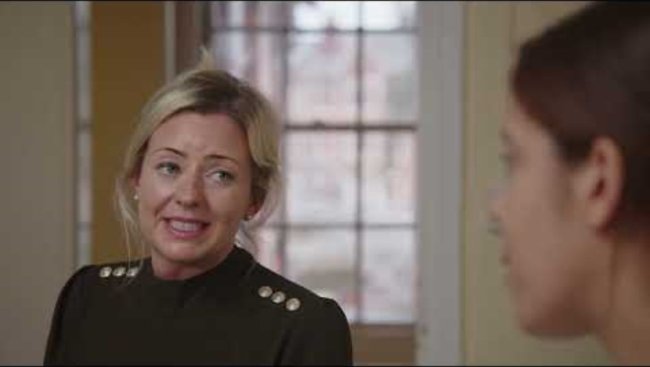
Scenario 2

Slide 61
SCENARIO EXERCISE
How did it feel in the role of:
Person experiencing behaviour
Perpetrator
Active Bystander
Which of the 5 D strategies could you have used?
What might you have done, or said?
Notes:
Also think about:
1. What was the inappropriate behaviour?
2. What could the drivers of the inappropriate behaviour be?
3. Why did those “good” people behave “badly?
4. Who else could have intervened? (include the victim)
5. Why didn’t they intervene?
Which of the 5 D Strategies could you use?
What might you have done or said?

Slide 62
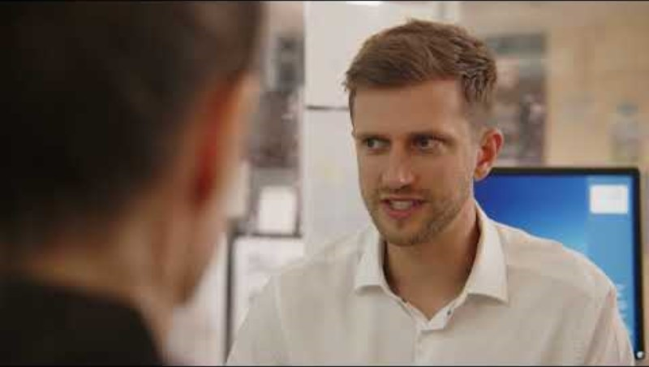
Scenario 3

Slide 63
SCENARIO EXERCISE
How did it feel in the role of:
Person experiencing behaviour
Perpetrator
Active Bystander
Which of the 5 D strategies could you have used?
What might you have done, or said?
Notes:
Also think about:
1. What was the inappropriate behaviour?
2. What could the drivers of the inappropriate behaviour be?
3. Why did those “good” people behave “badly?
4. Who else could have intervened? (include the victim)
5. Why didn’t they intervene?
Which of the 5 D Strategies could you use?
What might you have done or said?

Slide 64
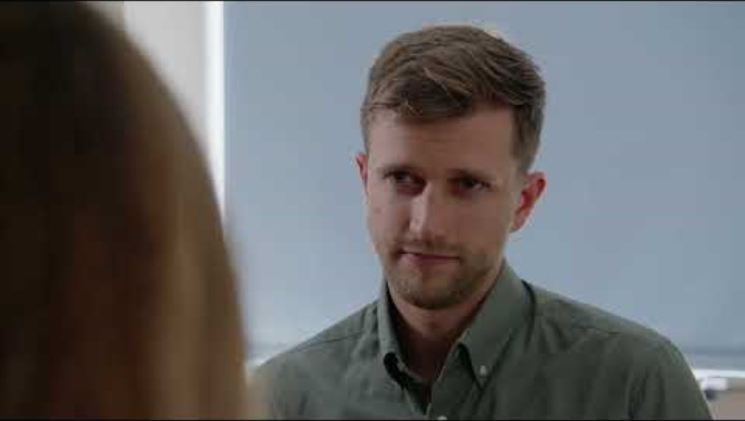
Scenario 4

Slide 65
SCENARIO EXERCISE
How did it feel in the role of:
Person experiencing behaviour
Perpetrator
Active Bystander
Which of the 5 D strategies could you have used?
What might you have done, or said?
Notes:
Also think about:
1. What was the inappropriate behaviour?
2. What could the drivers of the inappropriate behaviour be?
3. Why did those “good” people behave “badly?
4. Who else could have intervened? (include the victim)
5. Why didn’t they intervene?
Which of the 5 D Strategies could you use?
What might you have done or said?

Slide 66
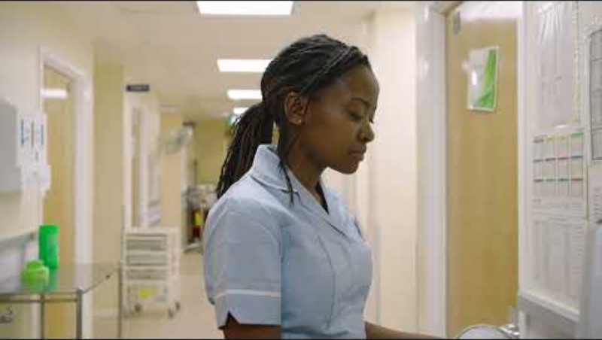
Scenario 5

Slide 67
SCENARIO EXERCISE
How did it feel in the role of:
Person experiencing behaviour
Perpetrator
Active Bystander
Which of the 5 D strategies could you have used?
What might you have done, or said?
Notes:
Also think about:
1. What was the inappropriate behaviour?
2. What could the drivers of the inappropriate behaviour be?
3. Why did those “good” people behave “badly?
4. Who else could have intervened? (include the victim)
5. Why didn’t they intervene?
Which of the 5 D Strategies could you use?
What might you have done or said?

Slide 68
1.Drivers of
Inappropriate
Behaviours
What stands
out from this material
for you?
2.Identifying Inappropriate
and
Unacceptable Behaviours
3.Why do
good people
behave badly?
REFLECTIONS
4.Why do good
people not
intervene when
they see others behaving badly?
How could you
use this in
your workplace?
5. Active Bystander Strategies

Slide 69

KEY TAKE AWAYS
Notes:
Afternoon Reflections and wrap up –
Ask what has stood out and what are their key take aways, maybe share:
something you have learned,
something you have observed and
what you will take away

Slide 70
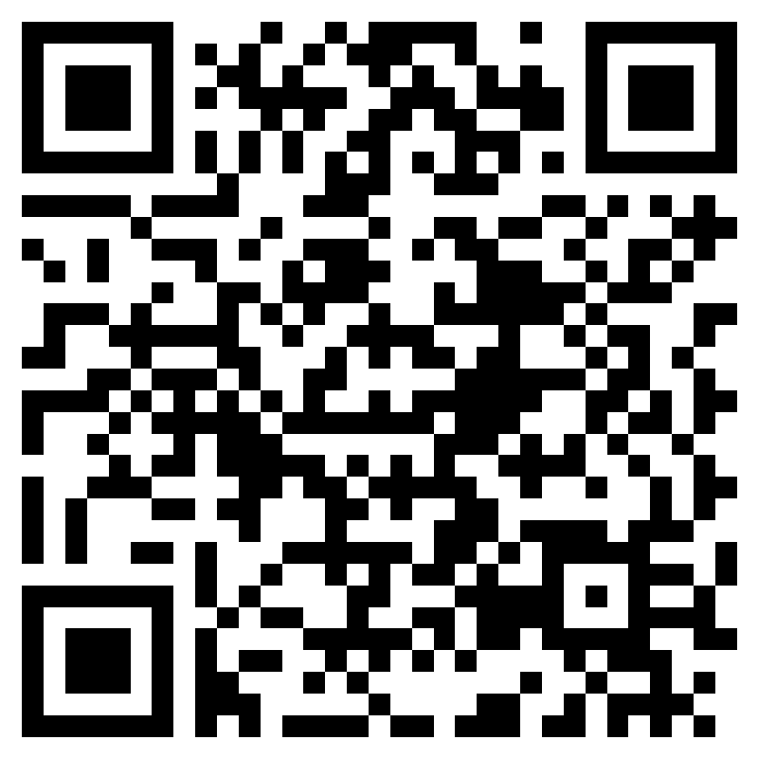

Complete
Post-session knowledge self-assessment
INSERT QR CODE FOR ONLINE POST KNOWLEDGE FORM
ABP Post Knowledge Questionnaire - https://forms.office.com/e/jL9WTheKPK?origin=lprLink

Slide 71
How would you rate ABP workshops from 1-10?
Tell us one thing you would do differently as a result of attending the course today?
Any other comments on today

Slide 72

NEXT STEPS
Action learning sets and on-going learning
and growth through reflection
Your Workbook
Connecting with each other to grow our
community and enhancing support

Slide 73
ACTION LEARNING SETS
INSERT DATES

Slide 74

YOUR SUPPORT
Internal Sponsors
System SRO - Daniela Locke, Deputy CPO, Wye Valley Trust daniela.locke@wvt.nhs.uk
Organisational Sponsors:
Janelle John, EDI Lead, H&W Health & Care Trust janelle.john2@nhs.net
Ali Koeltgen, CPO, Worcester Acute Hospitals Trust a.koeltgen@nhs.net
ICS support can be found on the wellbeing resources page of the ICS website
Looking After Our People :: Herefordshire and Worcestershire Integrated Care System
Worcester Acute: Visit the Health and Wellbeing Hub on the Trust Sharepoint (intranet)
Health & Care Trust: Visit the Mental Health Hub for a comprehensive wellbeing support package, including physiotherapy and 24/7 counselling services
Wye Valley Trust: Staff Wellbeing Hub http://www.hwstaffhub.nhs.net/
All other Organisations; Contact your local Health & Wellbeing Team, or,
Access your organisations' Employee Assistance Programme for support
Notes:
Edit to capture your internal sponsors, leads and your organisations support links and resources

Slide 75

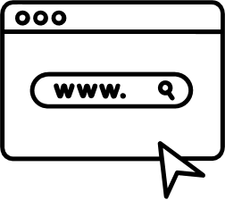

THANKYOU!
Connect with us at:
Kate.stephens12@nhs.net (ICS Project Lead)
https://www.hwics.org.uk/our-people/looking-after-you/active-bystander-programme
We ask that you do not share, edit or make copies of this presentation without prior consent from the LLR ICB via the LLR Academy

Slide 76
