Slide 1

Microsoft Teams Premium – AI / Co-Pilot
Digital Team
Summer of Learning 2025

Slide 2
Agenda
Microsoft Teams Premium Overview: What's in the box​
Key Features
Demo​
FAQ's​
Introduction into Co-Pilot
Pilot

Slide 3
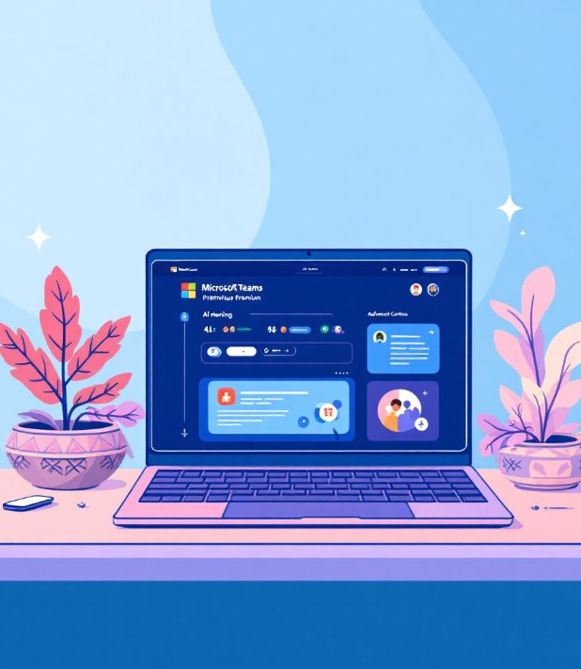
What is Microsoft Teams Premium?
Microsoft Teams Premium builds upon the standard Teams platform with sophisticated features designed for the modern workplace:
AI-powered meeting intelligence and productivity tools
Take meeting notes with the help of AI
Advanced webinar and virtual event capabilities
Enhanced security controls for sensitive content
Professional branding and customisation options
Productivity - removes manual note taking for meetings

Slide 4
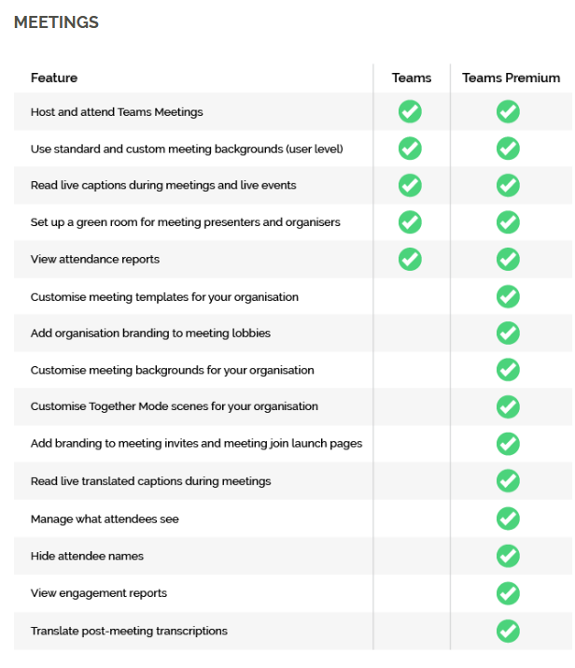
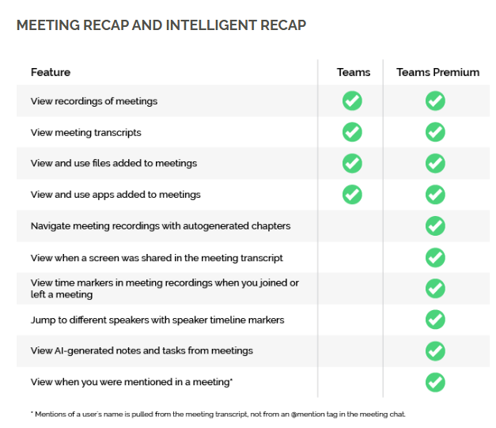
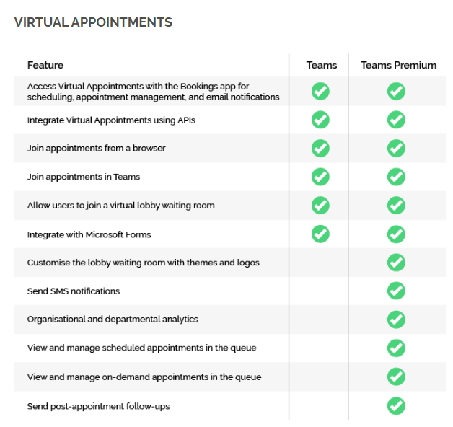
Microsoft Teams Premium Overview: What's in the box
Microsoft Teams Premium Overview: What's in the box
Difference between Teams and Premium?

Slide 5
Key Features
Intelligent Recap
AI Generated Notes & Tasks
Personalised Timeline Markers
Live Translated Caption
Watermarking
Sensitivity Labels

Slide 6
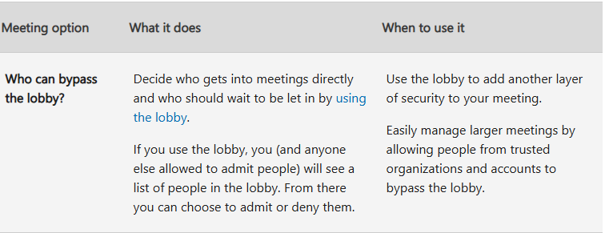
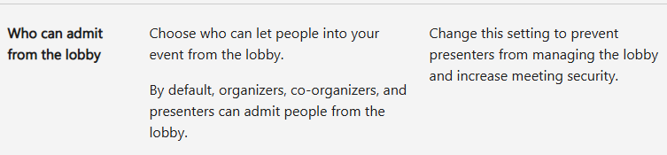
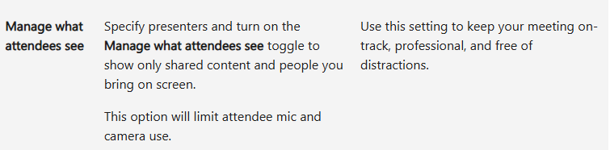
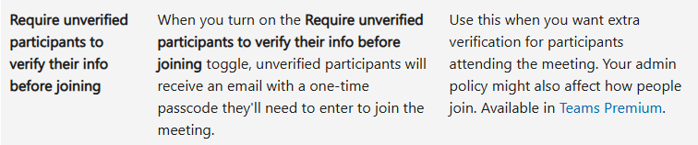
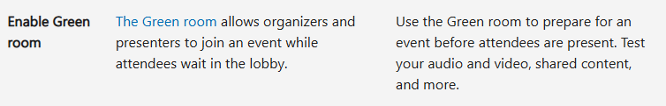
Microsoft Teams Premium Overview: What's in the box
Microsoft Teams Premium Overview: What's in the box
Meeting Options:

Slide 7
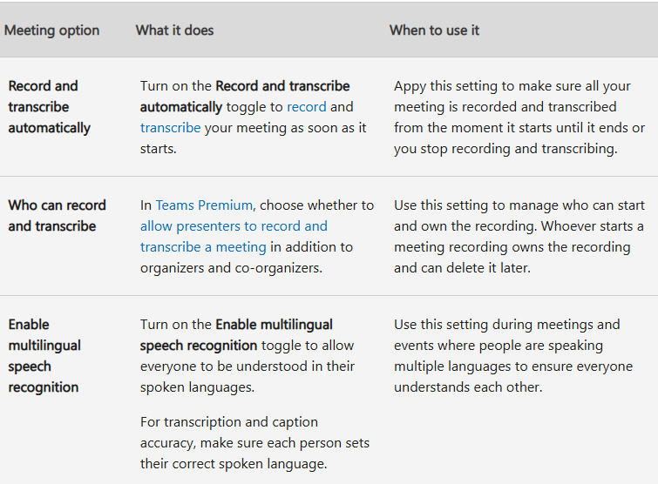
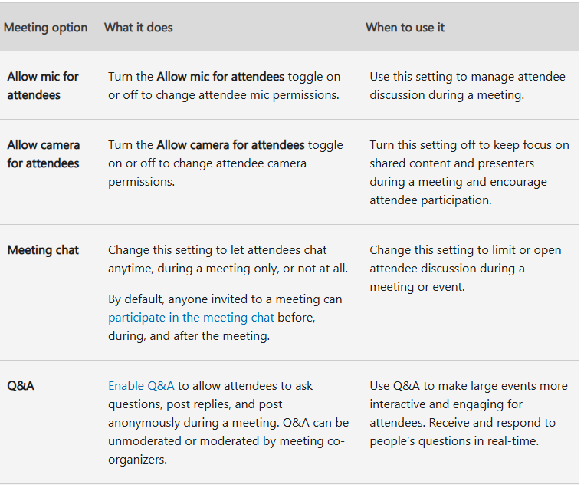
Microsoft Teams Premium Overview: What's in the box
Microsoft Teams Premium Overview: What's in the box
Meeting Options:

Slide 8
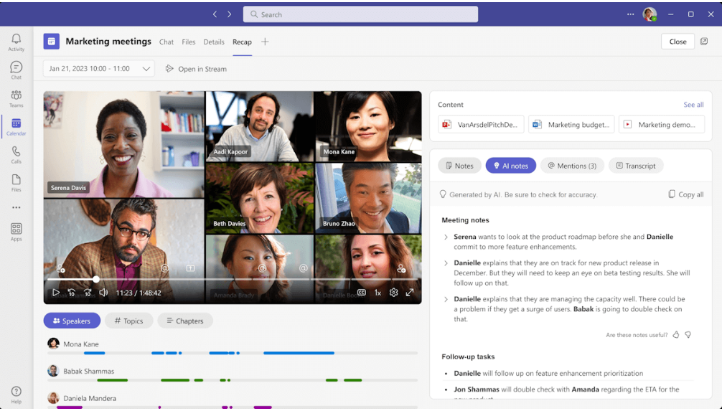
Microsoft Teams Premium Overview: What's in the box
Microsoft Teams Premium Overview: What's in the box
Intellinet Recap Results
Teams Premium
Documents
Notes Summary
Speakers Timeline
Meeting Tasks

Slide 9
Microsoft Teams Premium Overview: What's in the box
Microsoft Teams Premium Overview: What's in the box
ICB Pilot
Pilot - started in May with small user group
Weekly Meeting – discuss progress
Initial Challenges – multiple email identities
Governance – guidance document created
Approval – ELT
Status – Ready to assign licenses to staff

Slide 10
Demo

Slide 11
Governance
Although AI functionality with Teams Premium is advance, further checks are required of meeting notes for accuracy
Responsibility of meeting chair that notes are accurate before circulating to attendees
It is good practice etiquette to ensure that meeting attendees are aware that AI is being used to transcribe and summarise meeting notes.
Retention period for all recordings is 60 days and then the recording will be deleted unless you click on the individual recordings and set it not to expire
Use lobby and presenter controls to manage large or sensitive meetings.
Should not record meetings without participant consent first, especially with external attendees. If meeting attendees object to the meeting being recorded and AI being used, it is advised that this function is turned off. The meeting can still be recorded with the transcription and summarisation switched off.
Don’t allow external users to bypass the lobby unless necessary.
Not recommended using AI features with patients unless a clear policy has been agreed upon. Currently, our intention is to use these features exclusively for corporate ICB meetings and not for any patient engagement activities.

Slide 12
FAQs
Q: Is there an additional cost for MS Teams Premium license?
A: Yes, there is an additional cost for MS Teams Premium as it’s a different subscription
Q: Will everyone in the ICB receive a MS Teams Premium license?
A: It's not financially viable to give everyone a license, this will be based on your job role e.g. BSO will benefit from a license as it will help in them in their daily tasks.
Q: How do I request a license?
A: Please email the digital team once you have gained line managers approval and your request will be reviewed.
Q: Is there any guidance available:
A: The digital team have created a guidance document to help staff using Teams Premium
Q: Will Hoople require to install additional software
A: Hoople will activate the Teams Premium license on the central Microsoft license and within few hours the license will be ready to use.

Slide 13
Introduction to Microsoft Copilot
An AI-powered assistant embedded in Microsoft 365 (Word, Excel, PowerPoint, Outlook, Teams, etc.).
Powered by OpenAI’s GPT models + Microsoft Graph data.
Helps you write, summarize, analyze, visualize, and communicate better
Two versions: Copilot Chat & Microsoft 365 Copilot
Accesses data within your Microsoft 365

Slide 14
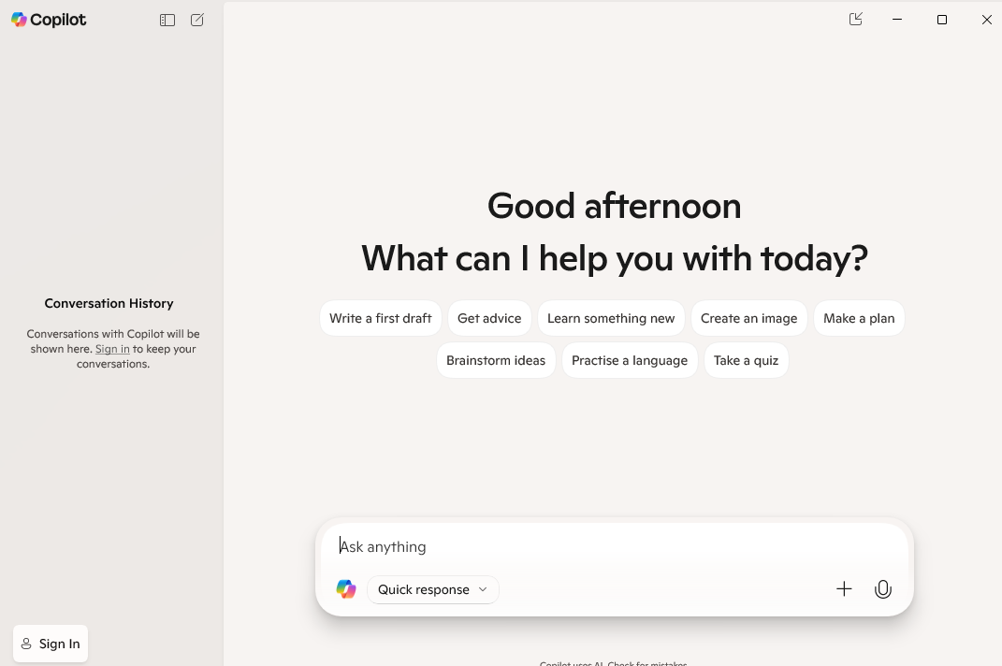
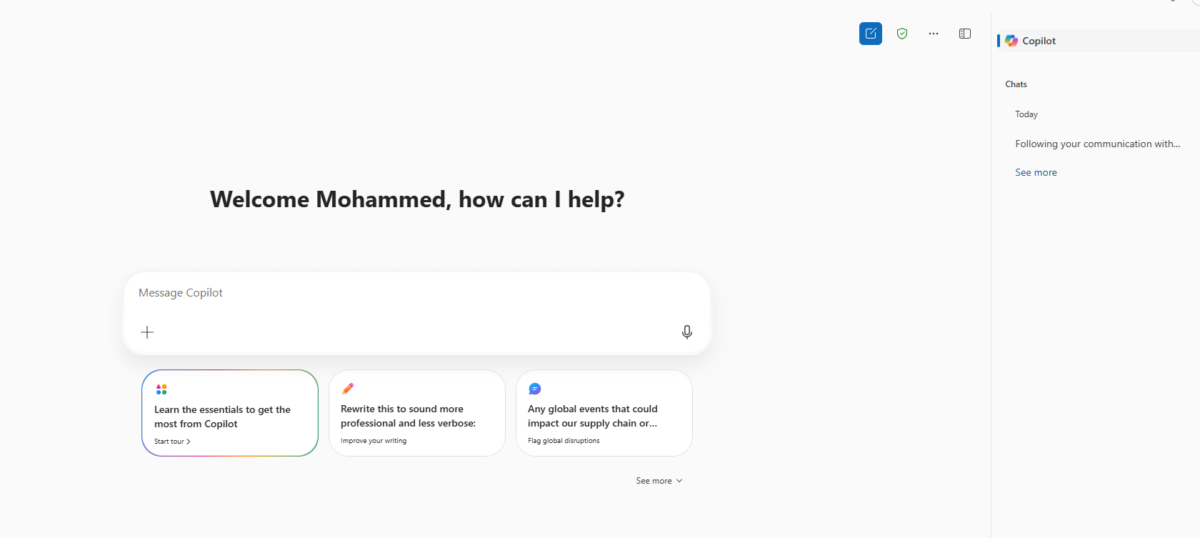
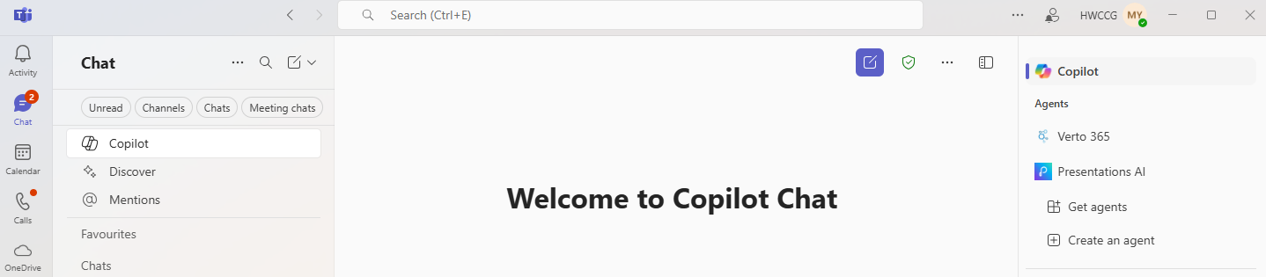
Accessing Copilot
3 Main Ways:
Windows:
Open the Copilot app from the Start menu, use the dedicated Copilot key (if your keyboard has one), or click the Copilot icon on the taskbar.
Microsoft 365:
Copilot is integrated into various apps like Word, Excel, and Teams. You can find it by looking for the Copilot icon or related options within the app's interface.
Web:
You can also access Copilot through a web browser by going to copilot.microsoft.com.

Slide 15
Copilot in Action
Summerise a PDF document
Visit - https://copilot.microsoft.com/
Add PDF or Word document
In prompt – Type summerise this document
Review content / improve
Copy and paste the text
In prompt type review text or expand
Microsoft Outlook:
Draft response back to email
Summerise an email
Analyse email threads and suggest meeting titles and agendas
PowerPoint
Turn text into slides, suggest layouts & visual
MS Teams:
Draft response to chat message, recap meetings, generate actions

Slide 16
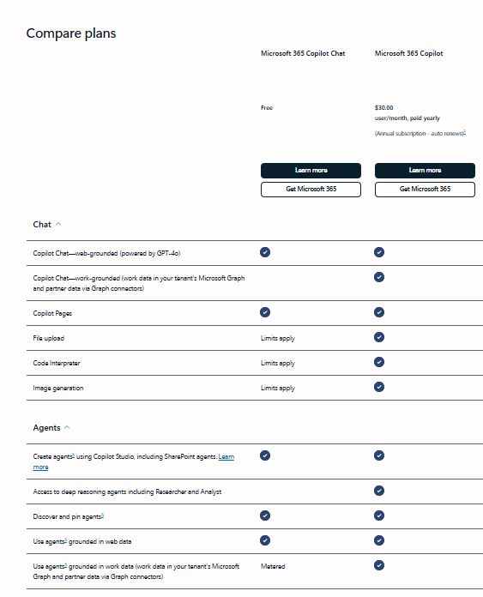
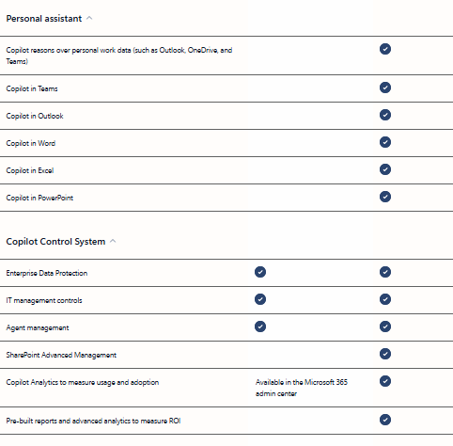
Microsoft Teams Premium Overview: What's in the box
Microsoft Teams Premium Overview: What's in the box
Copilot: Free v License

Slide 17

Copilot Isn't Perfect
May occasionally generate inaccurate or generic content.
Requires user oversight and editing.
Dependent on data quality and context.
Still evolving with frequent updates.

Slide 18
Microsoft Teams Premium Overview: What's in the box
Microsoft Teams Premium Overview: What's in the box
Further Information
Microsoft Teams Premium AI: Guidance​
Microsoft Copilot:
  https://copilot.microsoft.com/
NHS England: Introduction to Microsoft 365 Copilot
  https://support.nhs.net/knowledge-base/introduction-to-microsoft-365-copilot
NHS England: Teams Premium User Guides​
  https://support.nhs.net/knowledge-base/teams-premium-user-guides

