Slide 1
Entresto (Sacubitril/Valsartan)
Laura Clark
Senior Pharmacist E&T
March 2025

Slide 2
Contents
What is Heart Failure?
Heart Failure Treatments
How does Entresto work?
Doses and Indication
Side Effects and Monitoring
Counselling

Slide 3
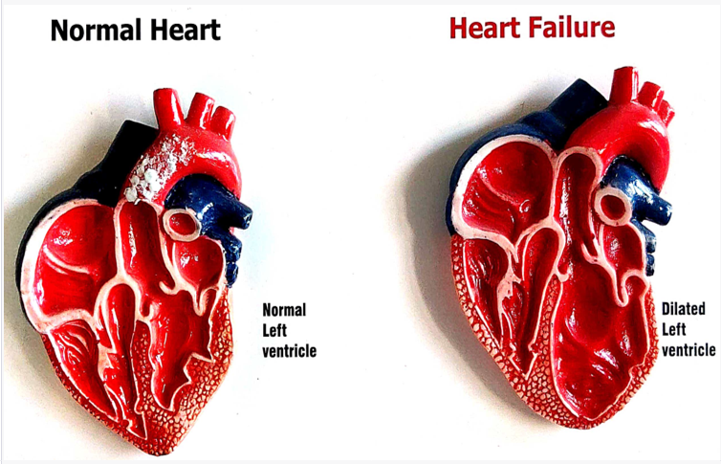
What is heart failure?
Heart function is reduced – tissue becomes less elastic and blood cannot empty from the chambers – increasing pressure in the chambers
Vasculature recognises low pressure and activates systems to increase pressure
Heart releases BNP to try to reduce fluid and pressure in the heart
Notes:
BNP (brain natriuretic peptide)
Causes can include arrhythmias, abnormal valves, heart attacks, congenital defects, some medicines including chemotherapies.

Slide 4
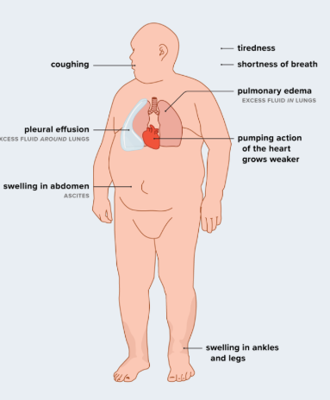
What is heart failure?
Classification | Definition
New York Heart Association Classification | NYHA-I – no limits to physical activity NYHA-II – some limits to physical activity NYHA-III – limited physical activity NYHA-IV – symptomatic at rest
Ejection Fraction | HFpEF >50% HFmrEF 40-50% HRrEF < 40%
Notes:
50% mortality over 5 years.
Patients are asked how many pillows they use at night, how far can they walk before they need to stop

Slide 5
What might you see on a Heart Failure Prescription?
Potassium Sparing Diuretic (Spironolactone / Eplerenone)
ACE inhibitors (Ramipril) OR Entresto
Beta Blocker (Bisoprolol)
SGLT2 inhibitor (Dapagliflozin)

Slide 6
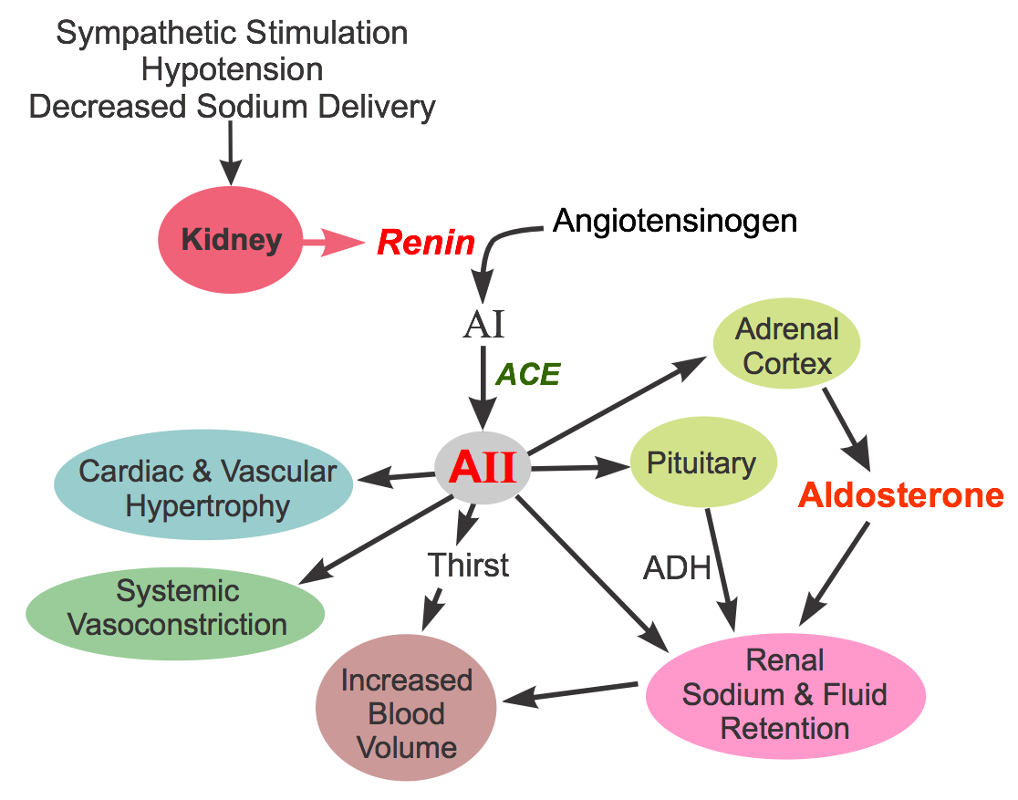
Entresto - Mechanism of Action
Vasculature recognises lower pressure, activates systems to increase
Valsartan – blocks angiotensin II, preventing hypertension, vasoconstriction
Left ventricle releases BNP when in trouble
Sacubitril – neprilysin inhibitor, preventing break down of BNP
Notes:
Sacubitril-Valsartan - StatPearls - NCBI Bookshelf

Slide 7
Entresto - Indication and Dose
Heart Failure with Reduced Ejection Fraction (HFrEF)
  No evidence in preserved (HFpEF)/ moderately reduced ejection fraction (HFmrEF)
Patients who were not previously taking an ACE inhibitor/ARB | 24/26mg BD starting dose Increase every 3-4 weeks to target 97/103mg BD
Patients who were previously taking an ACEi/ARB | 49/51mg BD starting dose Lower starting dose of 24/26mg BD if patient low BP Target 97/103mg BD

Slide 8
Entresto - Side Effects and Monitoring
Side Effect | Action / Monitoring
Can cause angioedema (skin/tissue swelling) if given with ACE inhibitors | 36 hour washout period for switching from ACE inhibitors to entresto
Hyperkalaemia (increased potassium) | Full U&Es taken after each dose adjustment
Renal impairment
Low blood pressure | Blood pressure monitoring. Not to go below 100mmHg systolic
Notes:
Lower targets in heart failure patients. Do not

Slide 9
Interesting Reads!
Heart failure | British Heart Foundation – BHF
CPPE Courses on Heart Failure are available
Entresto 97 mg/103 mg film-coated tablets - Summary of Product Characteristics (SmPC) - (emc) | 5074
Heart failure - chronic | Health topics A to Z | CKS | NICE
2021 ESC Guidelines for the diagnosis and treatment of acute and chronic heart failure
Classes and Stages of Heart Failure | American Heart Association

